Slide 1
Qt Training – Widget Edition
March 20168
Based on Qt 5.10
N.N.
N.N@company.com

Slide 2
Contents
Widgets | Common Widgets Layout Management Guidelines for Custom Widgets
State Machines and Animations | Animation Framework Animation Groups State Machines State-Based User Interfaces
Painting and Styling | Painting on Widgets Color Handling Painting Operations Styles and Style Sheets
Application Creation | Main Windows Settings Resources Translation for Developers Deploying Qt Applications

Slide 3
Contents
Dialogs | Dialogs Common Dialogs Qt Designer
Model/View Framework | Model/View Concept Showing Simple Data Proxy Models Custom Models Delegates Editing item data Data Widget Mapper Drag and Drop Custom Tree Model Data Widget Mapper

Slide 4
Contents
GraphicsView | Using GraphicsView Classes Coordinate Systems and Transformations Creating Custom Items Widgets in a Scene Drag and Drop Effects Performance Tuning
Charts | Chart Types Using Qt Model Data in Charts Dynamic Charts User Interactions Themes and Customization

Slide 5
Qt GUI Options
UI | Typical Use Cases | Features
Widgets | Desktop-like UIs with menus, toolbars, status bars, dialogs | No GPU needed Memory efficient Custom styling
Graphics View | Mostly prior Qt5 for lightweight, rich Uis | Memory efficient Can handle thousands of UI items No UI controls
3D | 3D UI, games, visualizations | 3D engine, 3D data visualization
Qt Quick | Rich UIs with fancy graphical effects, desktop, embedded, mobile | Fluid user experience easy to achieve Declarative programming Rendering optimizations Memory intensive Multicore CPU and GPU beneficial
Web Engine | Web-based UI, hybrid apps | No need to learn C++ or QML Existing web-based Uis easy to use with Qt Easy to expose Qt objects to JavaScript

Slide 6
Widgets

Slide 7
Contents
Common Widgets
Layout Management
Guidelines for Custom Widgets

Slide 8
Objectives
Common Widgets
Text widgets
Value based widgets
Organizer widgets
Item-based widgets
Layout Management
Geometry management
Advantages of layout managers
Qt's layout managers
Size policies
Custom Widgets
Rules for creating own widgets

Slide 9
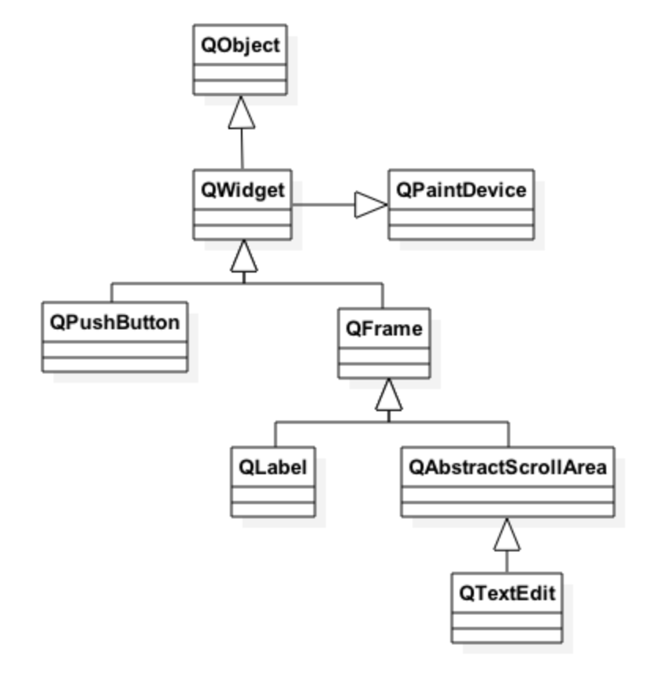
Qt’s Widget Model - QWidget
Derived from QObject
Adds visual representation
Base of user interface objects
Receives events
e.g. mouse, keyboard events
Paints itself on screen
Using styles

Slide 10
Object Tree and QWidget
new QWidget(0)
Widget with no parent = "window" – QWindow created in the platform abstraction
AKA top-level widget
QWidget’s children
Positioned in parent’s coordinate system
Clipped by parent’s boundaries
QWidget parent
Propagates state changes
Hides/shows children when it is hidden/shown itself
Enables/disables children when it is enabled/disabled itself
Tristate mechanism
For hide/show and enable/disable, ensures that e.g. an explicitly hidden child is not shown when the parent is shown.

Slide 11
Common Widgets

Slide 12
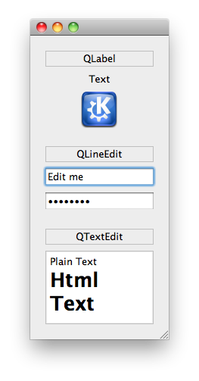
Text Widgets
QLabel
label = new QLabel("Text", parent);
setPixmap( pixmap ) - as content
QLineEdit
line = new QLineEdit(parent);
line->setText("Edit me");
line->setEchoMode(QLineEdit::Password);
connect(line, SIGNAL(textChanged(QString)) ...
connect(line, SIGNAL(editingFinished()) ...
setInputMask( mask )
setValidator( validator )
QTextEdit
edit = new QTextEdit(parent);
edit->setPlainText("Plain Text");
edit->append("<h1>Html Text</h1>");
connect(edit, SIGNAL(textChanged(QString)) ...

Slide 13
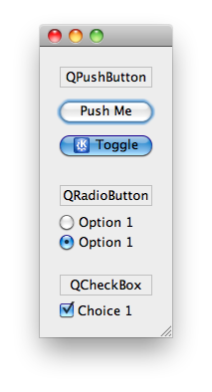
Button Widgets
QAbstractButton
Abstract base class of buttons
QPushButton
button = new QPushButton("Push Me", parent);
button->setIcon(QIcon("images/icon.png"));
connect(button, SIGNAL(clicked()) ...
setCheckable(bool)-togglebutton
QRadioButton
radio = new QRadioButton("Option 1", parent);
QCheckBox
check = new QCheckBox("Choice 1", parent);
QButtonGroup - non-visual button manager
group = new QButtonGroup(parent);
group->addButton(button); // add more buttons
group->setExclusive(true);
connent(group, SIGNAL(buttonClicked(QAbstractButton*))

Slide 14
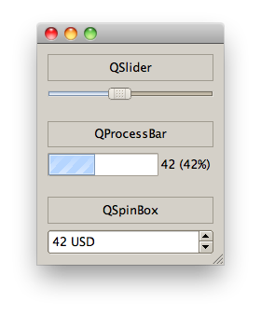
Value Widgets
QSlider
slider = new QSlider(Qt::Horizontal, parent);
slider->setRange(0, 99);
slider->setValue(42);
connect(slider, SIGNAL(valueChanged(int)) ...
QProgressBar
progress = new QProgressBar(parent);
progress->setRange(0, 99);
progress->setValue(42); // format: %v for value; %p for percentage
progress->setFormat("%v (%p%)");
QSpinBox
spin = new QSpinBox(parent);
spin->setRange(0, 99);
spin->setValue(42);
spin->setSuffix(" USD");
connect(spin, SIGNAL(valueChanged(int))

Slide 15
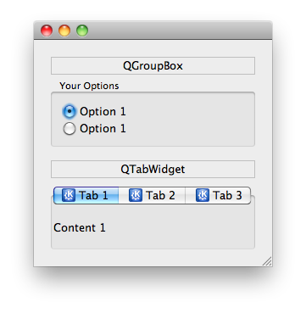
Organizer Widgets
QGroupBox
box = new QGroupBox("Your Options", parent);
// ... set layout and add widgets
setCheckable( bool ) - checkbox in title
QTabWidget
tab = new QTabWidget(parent);
tab->addWidget(widget, icon, "Tab 1");
connect(tab, SIGNAL(currentChanged(int)) ...
setCurrentWidget( widget )
Displays page associated by widget
setTabPosition( position )
Defines where tabs are drawn
setTabsClosable( bool )
Adds close buttons

Slide 16
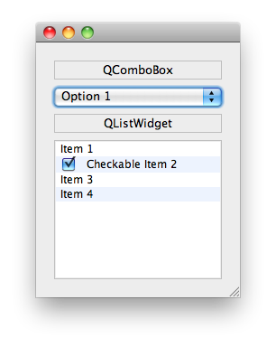
Item Widgets
QComboBox
combo = new QComboBox(parent);
combo->addItem("Option 1", data);
connect(combo, SIGNAL(activated(int)) ...
QVariant data = combo->itemData(index);
setCurrentIndex( index )
QListWidget
list = new QListWidget(parent);
list->addItem("Item 1");
// ownership of items with list
tem = new QListWidgetItem("Item 2", list); item->setCheckState(Qt::Checked);
connect(list, SIGNAL(itemActivated(QListWidgetItem*)) ...
QListWidgetItem::setData(Qt::UserRole, data)
Other Item Widgets: QTableWidget, QTreeWidget

Slide 17
Other Widgets
QToolBox
Column of tabbed widget items
QDateEdit, QTimeEdit, QDateTimeEdit
Widget for editing date and times
QCalendarWidget
Monthly calendar widget
QToolButton
Quick-access button to commands
QSplitter
Implements a splitter widget
QStackedWidget
Stack of widgets
Only one widget visible at a time

Slide 18
Layout Management

Slide 19
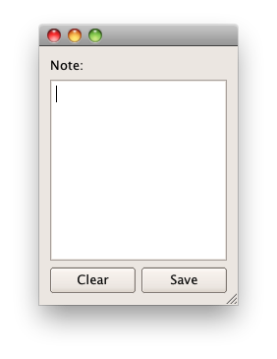
Widgets that Contain Other Widgets
Container Widget
Aggregates other child-widgets
Use layouts for aggregation
In this example: QHBoxLayout and QVBoxLayout
Note: Layouts are not widgets
Layout Process
Add widgets to layout
Layouts may be nested
Set layout on container widget

Slide 20
Container Widget: QScrollArea
QScrollArea provides on-demand scrollbars for a single child widget
QScrollArea works by scrolling a single (large) child widget provided by the programmer
QAbstractScollArea is the base class of QScrollArea and can by used when full control over the scrollbars and scrolling process is required
Most window systems limit the size of a widget in both directions to be smaller than 2¹⁶, but Qt deals with this limitation in a way that is transparent to the programmer
It is no problem to have a huge widget (up to 2³¹-1 pixels in each direction) inside a QScrollArea

Slide 21
QScrollArea
Create an instance of QScrollArea and the widget that should be inside the scrolled area
Call QScrollArea::setWidget() with a pointer to the widget. Note that the scroll area takes ownership of the widget.
If the widget is a plain QWidget, you’ll have to set its minimum size to avoid that it shrinks beyond intention
Add a layout manager to the widget, and add subwidgets at your leisure
Optionally call QScrollArea::setWidgetResizable(true)
This will make this widget resize to the size of the viewport in case it is smaller than the viewport

Slide 22
Organization
Scrollbars will by default be shown when needed. This behavior can, however, be configured using setVerticalScrollBarPolicy() and setHorizontalScrollBarPolicy()
The value passed to the two methods is one of
Qt::ScrollBarAsNeeded
Qt::ScrollBarAlwaysOff
Qt::ScrollBarAlwaysOn
Space can be reserved outside the viewport, but still in between the scroll bars, using setViewportMargins()
ex-scroll-area-margins

Slide 23
Container Widget: QMdiArea
QMdiArea – Window manager for sub-windows
Supports tiling and cascading sub-windows
Provides slots to add, remove, and activate sub-windows
QAbstractScrollArea subclass (by default scroll bars off)
Subclass and use the viewport to define the visible area size
Two view modes: subwindow with frames and tabbed mode
QMdiSubWindow
Document (QWidget) container
Manage your windows with “standard” window methods (show(), showMaximized(), showFullScreen(), hide(), move(), etc.)
Provides a sub-window list (in the creation, stacking or activation history order)
ex-mdi

Slide 24
Layout Management – Doing it Yourself
Place and resize widgets
move()
resize()
setGeometry()
Example:
QWidget *parent = new QWidget(...);
parent->resize(400,400);
QCheckBox *cb = new QCheckBox(parent);
cb->move(10, 10);

Slide 25
Layout Management – Let Qt Handle the Layout
Define the position and size for top-level widgets only
setGeometry(), resize() or move()
Manage the layout of child widgets with layout classes
Makes your UI scalable
Takes LTR and RTL into account
Takes font sizes into account
All layout classes subclass QLayout
Not a widget itself
QHBoxLayout, QVBoxLayout, QStackedLayout, QGridLayout, QFormLayout
Some widgets use directly the layouts: QTabWidget and QStackedWidget use QStackedLayout

Slide 26
Managed Widgets and Sizes
Managed widget = a widget geometry is managed by a layout
The layout is based on widget and layout properties
virtual QSize QWidget::sizeHint() – recommended size for the widget in the layout
virtual QSize QWidget::minimumSizeHint() – recommended minimum size for the widget in the layout
Stretch factor, strut etc.
Instead of re-implementing the virtual functions, it is possible to call
QWidget::setFixedSize() – minimum and maximum sizes set to the same value
QWidget::setMinimumSize()
QWidget::setMaximumSize() – The default maximum is QWIDGETSIZE_MAX (2<<24) - 1

Slide 27
Layout Management Classes
QHBoxLayout
Lines up widgets horizontally
QVBoxLayout
Lines up widgets vertically
QGridLayout
Arranges the widgets in a grid
QFormLayout
Lines up a (label, widget) pairs in two columns.
QStackedLayout
Arranges widgets in a stack
Only top most is visible

Slide 28
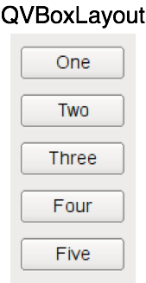
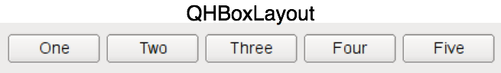
QHBoxLayout and QVBoxLayout
Lines up widgets horizontally or vertically
Divides space into boxes
Each managed widgets fills in one box
QWidget* window = new QWidget;
QPushButton* one = new QPushButton("One");
…
QHBoxLayout* layout = new QHBoxLayout;
layout->addWidget(one);
…
window->setLayout(layout);

Slide 29
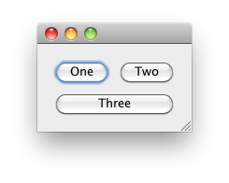
Widgets in a Grid - QGridLayout
QWidget* window= new QWidgetn;
QPushButton* one = new QPushButton("One");
QGridLayout* layout = new QGridLayout;
layout->addWidget(one, 0, 0); // row:0, col:0
layout->addWidget(two, 0, 1); // row:0, col:1
// row:1, col:0, rowSpan:1, colSpan:2
layout->addWidget(three, 1, 0, 1, 2);
window->setLayout(layout)
Additional
setColumnMinimumWidth() (minimum width of column)
setRowMinimumHeight() (minimum height of row)
No need to specify rows and columns before adding children
ex-grid-layout

Slide 30
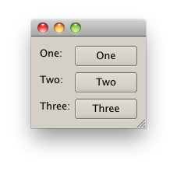
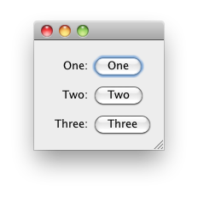
QFormLayout
A two-column layout
Column 1 a label (as annotation)
Column 2 a widget (as field)
Respects style guide of individual platforms.
QWidget* window = new QWidget();
QPushButton* one = new QPushButton("One"); …
QFormLayout* layout = new QFormLayout();
layout->addRow("One", one);
..
window->setLayout(layout)
Form layout with clean looks and mac style
ex-layout

Slide 31
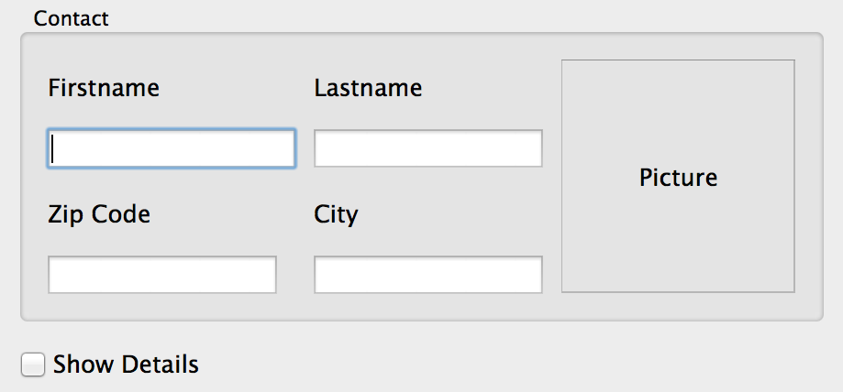
Lab – Contact Form
Specified by graphic designer
Your task: implement it
Focus on correct layout
Details disabled by default
'ShowDetails’ enables details
Optional:
Click on Picture
Lets user choose image
See lab description
Validate Zip-Code as integers
lab-contact-form

Slide 32
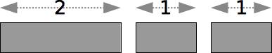
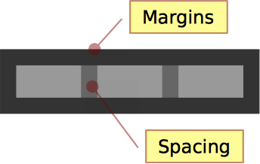
Some Layout Terms
Stretch
Relative size factor
QBoxLayout::addWidget(widget, stretch)
QBoxLayout::addStretch(stretch)
QGridLayout::setRowStretch(row, stretch)
QGridLayout::setColumnStretch(col, stretch)
Contents Margins
Space reserved around the managed widgets.
QLayout::setContentsMargins(l,t,r,b)
Spacing
Space reserved between widgets
QBoxLayout::addSpacing(size)

Slide 33
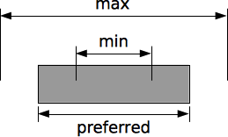
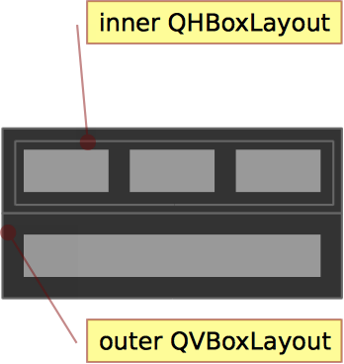
More Layout Terms
Strut
Limits perpendicular box dimension
e.g. height for QHBoxLayout
Only for box layouts
Min, max and fixed sizes
QWidget::setMinimumSize( QSize )
QWidget::setMaximumSize( QSize )
QWidget::setFixedSize( QSize )
Individual width and height constraints also available
Nested Layouts
Allows flexible layouts
QLayout::addLayout(...)
ex-custom-layout

Slide 34
Widgets Size Policies
QSizePolicy describes interest of widget in resizing
QSizePolicy policy = widget->sizePolicy();
policy.setHorizontalPolicy(QSizePolicy::Fixed);
widget->setSizePolicy(policy);
One policy per direction (horizontal and vertical)
Button-like widgets set size policy to the following:
May stretch horizontally
Are fixed vertically
Similar to QLineEdit, QProgressBar, ...
Widgets which provide scroll bars (e.g. QTextEdit)
Can use additional space
Work with less than sizeHint()
sizeHint(): recommended size for widget

Slide 35
Available Size Policies
Policy | sizeHint() | Widget
Fixed | authoritative | cannot grow or shrink
Minimum | minimal, sufficient | can expand, no advantage of being larger
Maximum | is maximum | can shrink
Preferred | is best | can shrink, no advantage of being larger
Minimum Expanding | is minimum | can use extra space
Expanding | sensible size | can grow and shrink

Slide 36
Questions And Answers
How do you change the minimum size of a widget
Name the available layout managers.
How do you specify stretch? When are you allowed to call resize and move on a widget?

Slide 37
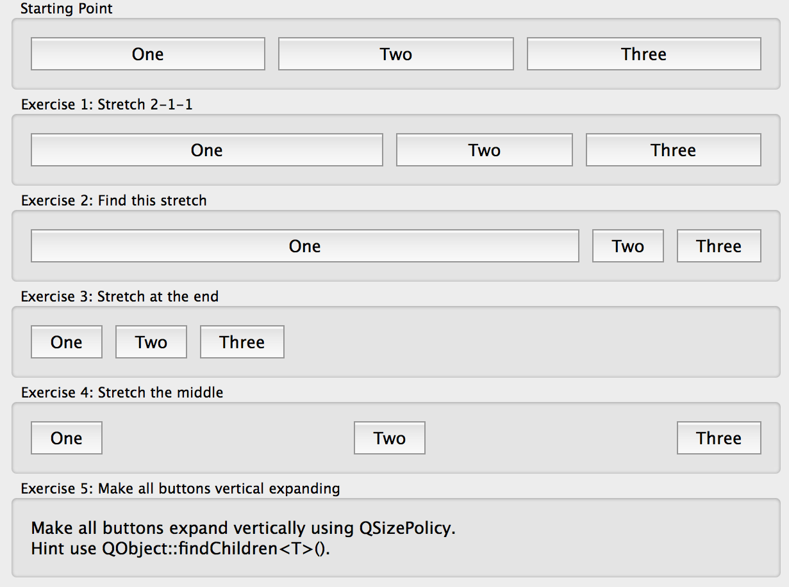
Lab – Layout of buttons
Develop the following layouts
Adjust the layouts as shown below.
Optionally:
Make buttons resize vertically when making the window higher.
lab-layout-buttons

Slide 38
Guidelines for Custom Widgets

Slide 39
Guidelines: Creating a Custom Widget
It's as easy as deriving from QWidget
If you need custom Signal Slots
Add Q_OBJECT
Use layouts to arrange widgets inside, or paint the widget yourself
class CustomWidget : public QWidget
{
public:
explicit CustomWidget(QWidget* parent=0,
Qt::WindowFlags flags = Qt::WindowFlags()));
}

Slide 40
Window Flags
Window-system properties for a window
QWidget(Qwidget *parent = Q_NULLPTR, Qt::WindowFlags f = Qt::WindowFlags())
void setWindowFlags(Qt::WindowFlags flags);
Qt::FramelessWindowHint – Produces a borderless window
Qt::WindowStaysOnTopHint – Window stays on top
Qt::WindowStaysOnBottomHint
Qt::WindowTransparentForInput – Window is used only for output
Qt::WindowDoesNotAcceptFocus

Slide 41
Guidelines: Base Class and Event Handlers
Do not reinvent the wheel
Decide on a base class
Often QWdget or QFrame
Overload needed event handlers
Often:
QWidget::mousePressEvent(),
QWidget::mouseReleaseEvent()
If widget accepts keyboard input
QWidget::keyPressEvent()
If widget changes appearance on focus
QWidget::focusInEvent(),
QWidget::focusOutEvent()

Slide 42
Guidelines: Drawing a Widget
Decide on composite or draw approach
If composite: Use layouts to arrange other widgets
If draw: implement paint event
Re-implement QWidget::paintEvent() for drawing
To draw widget's visual appearance
Drawing often depends on internal states
Decide which signals to emit
Usually from within event handlers
Especially mousePressEvent() or mouseDoubleClickEvent()
Decide carefully on types of signal parameters
General types increase reusability
Candidates are bool, int and const QString&

Slide 43
Guidelines: Internal States and Sub-classing
Decide on publishing internal states
Which internal states should be made publically accessible?
Implement accessor methods
Decide which setter methods should be slots
Candidates are methods with integral or common parameters
Decide on allowing sub-classing
If yes
Decide which methods to make protected instead of private
Which methods to make virtual

Slide 44
Guidelines: Widget Constructor
Decide on parameters at construction time
Enrich the constructor as necessary
Or implement more than one constructor
If a parameter is needed for widget to work correctly
User should be forced to pass it in the constructor
Keep the Qt convention with:
explicit Constructor(..., QWidget *parent = Q_NULLPTR,
Qt::WindowFlags flags)

Slide 45
Summary
Widgets provide one option to implement user interfaces in Qt programs
Qt has a large selection of ready-made widgets
Ready-made widgets may be aggregated together to have more complicated custom widgets
Layout management takes care of positioning and resizing child widgets
Qt has layout widgets and layout manager classes
Horizontal and vertical size policies define, how child widgets size changes in the layout
Custom widgets can be done by re-implementing the paintEvent() method as well

Slide 46
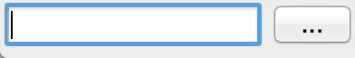
Lab – File Chooser
Create a reusable file chooser component
2 Modes
Choose File
Choose Directory
Think about the Custom Widget Guidelines!
Create a reusable API for a FileChooser?
After lab discuss your API
lab-file-chooser

Slide 47
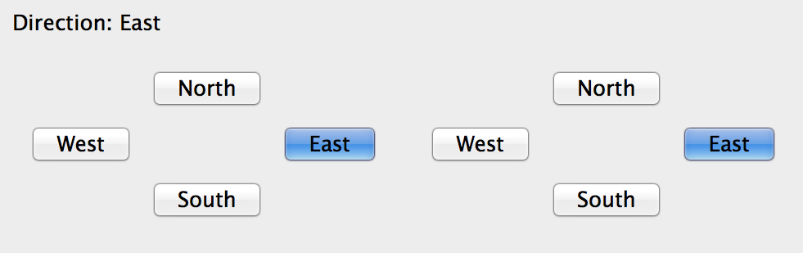
Lab – Compass Widget
Implement a “compass widget” and let user...
Select a direction
north, west, south, east
And optionally none
Provide API to…
Change direction programmatically
Get informed when direction changes
Optional
Add direction None
Select direction with the keyboard
lab-compass-widget

Slide 48
State Machines and Animations

Slide 49
Contents
Animation Framework
Animation Groups
State Machines
State-Based User Interfaces

Slide 50
Objectives
Learn…
…how to implement state-based user interfaces
…how to animate widgets
…how to use states with animations

Slide 51
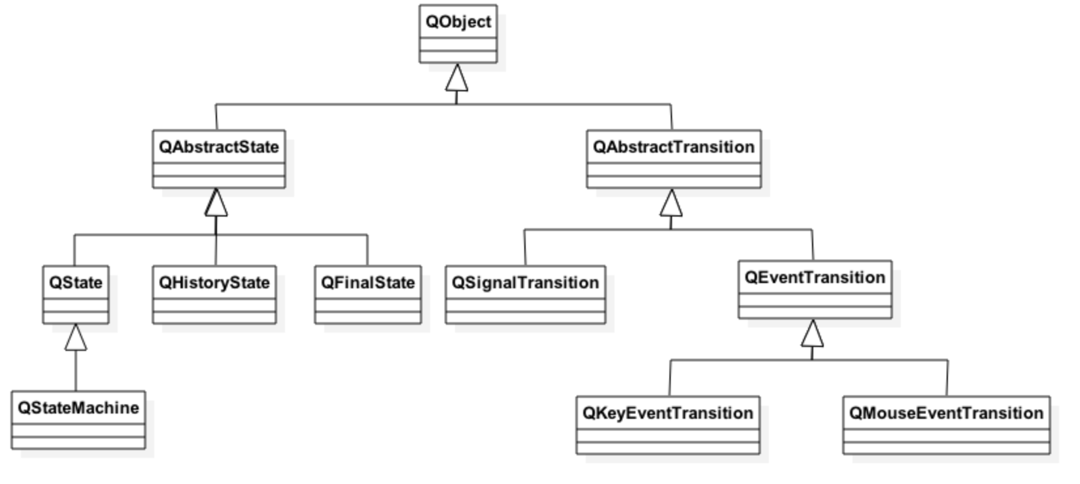
State Machine Framework

Slide 52
First State Machine
Conceptually our state machine could be presented as shown below
State 1 is the initial state
In the next few slides we will fill in the source code and run the application as a simple demo
Useful base class signals:
QAbstractState::entered() and
QAbstractState::exited()
s1
button.clicked
s2
button.clicked
s3
button.clicked

Slide 53
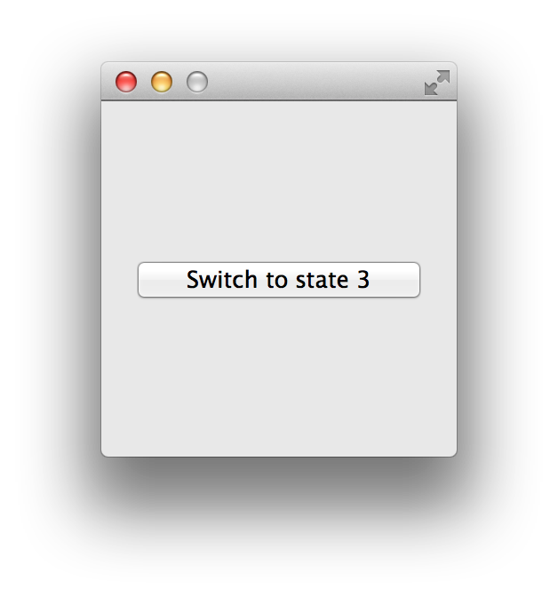
First State Machine
The initial application could be written as follows
int main(int argc, char *argv[])
{
QApplication a(argc, argv);
QWidget window;
window.setFixedSize(200, 200);
QPushButton* button = new QPushButton("Switch to state 2", &window);
window.show();
return a.exec();
}
ex-state-machine

Slide 54
First State Machine
QStateMachine* machine = new QStateMachine(&window);
QState *s1 = new QState();
QState *s2 = new QState();
QState *s3 = new QState();
s1->addTransition(button, &QPushButton::clicked, s2);
s2->addTransition(button, &QPushButton::clicked, s3);
s3->addTransition(button, &QPushButton::clicked, s1);
machine->addState(s1);
machine->addState(s2);
machine->addState(s3);
machine->setInitialState(s1); machine->start();

Slide 55
First State Machine
So far our state machine does not perform any meaningful work
Typically such work means changing the properties of various QObjects in the application
For example, the button’s text:
How would you make the button move to a different position each time the state changes?
How about changing the window title to display the current state?
s1->assignProperty(button, "text", "Switch to state 2");
s2->assignProperty(button, "text", "Switch to state 3");
s3->assignProperty(button, "text", "Switch to state 1");

Slide 56
Grouping States
Consider a situation where a common transition needs to be made regardless of the current state
E.g. switch to a final state when user clicks a quit button
The first solution: add a transition to the final state from each of the existing states (1-3 in our example)
Not very scalable – need to remember to add the same transition to each new state as well
The proper solution: group the states as children of a single top-level state
The parent state gets the transition to the final state
The transition is automatically inherited by the child states – also by new ones added later!
A child state can also override an inherited transition

Slide 57
Grouping States
rootState
s1
button.clicked
s2
button.clicked
button.clicked
s3
quitButton.clicked

Slide 58
Grouping States
QState *rootState = new QState();
QState *s1 = new QState(rootState); // Notice that rootState is the parent state
QState *s2 = new QState(rootState);
QState *s3 = new QState(rootState);
QFinalState *finalState = new QFinalState(); // Final state is top-level
// Root state is entered as the machine starts…
machine->setInitialState(rootState);
// …and state 1 is entered immediately after that
rootState->setInitialState(s1);
// Only top-level states are added to the state machine
machine->addState(rootState);
machine->addState(finalState);
// New transition, other transitions stay as they were
rootState->addTransition(quitButton, &QPushButton::clicked, finalState);
QObject::connect(machine, &QStateMachine::finished, qApp, &QApplication::quit);
machine->start();

Slide 59
Animation Framework
The idea is to provide an easy and scalable way of creating animated and smooth GUIs
Hides the complexity of handling timers
Provides a set of pre-defined easing curves, custom curves can be provided by the developer as needed
Works by modifying the properties of the QObjects being animated
Easy to use together with the State Machine Framework to provide animated transitions between states
Normally the animations have a finite duration
QTimeLine used as a timer behind the scenes
Can be made to loop and run backwards
If duration is set to -1, the animation will run until explicitly stopped

Slide 60
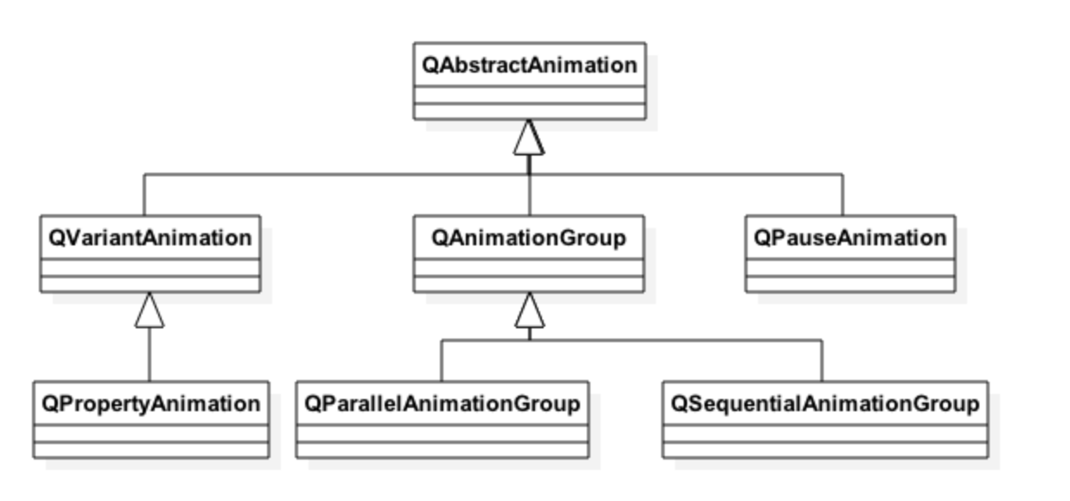
Animation Classes

Slide 61
Example – Animating a Button
QPushButton button("Animated Button");
button.show();
// This is a main() function. That’s why we can allocate the animation in the stack
QPropertyAnimation animation(&button, "geometry");
animation.setDuration(10000); animation.setStartValue(QRect(0, 0, 100, 30));
animation.setKeyValueAt(0.5, QRect(250, 250, 100, 30));
animation.setEndValue(QRect(0, 0, 100, 30));
animation.start();

Slide 62
Animation Groups
Classes QSequentialAnimationGroup and QParalleAnimationGroup can be used to run multiple animations in sequence or in parallel
An animation group can be used wherever a ”normal” animation could – e.g. a group within a group
Enables building very complex animation sequences
QPropertyAnimation* animation1 = new QPropertyAnimation(...);
QPropertyAnimation* animation2 = new QPropertyAnimation(...);
QPropertyAnimation* animation3 = new QPropertyAnimation(...);
QPropertyAnimation* animation4 = new QPropertyAnimation(...);
QParallelAnimationGroup *parallel = new QParallelAnimationGroup();
parallel->addAnimation(animation2);
parallel->addAnimation(animation3);
QSequentialAnimationGroup* seq = new QSequentialAnimationGroup();
seq->addAnimation(animation1);
seq->addAnimation(parallel);
seq->addAnimation(animation4);
seq->start();

Slide 63
Easing Curves
The Animation FW provides multiple pre-made easing curves for your convenience
Represented by the class QEasingCurve
Custom curves can made by the developer; see the class documentation for details
Typically used to control e.g. how the animation starts and/or finishes
QEasingCurve::OutBounce
QEasingCurve::InOutQuad
…
QPropertyAnimation animation(&button, "geometry");
animation.setEasingCurve(QEasingCurve::OutBounce);

Slide 64
Animations with a State Machine
As mentioned before, the Animation FW can easily be made to work with the State Machine FW
Simply a matter of assigning one or more animations for each wanted state transition
Works the same way for both QSignalTransitions and QEventTransitions
In this case a property animation itself does not need a start or an end value
These come from the states in the state machine
Intermediate values can be set as before using the base class QVariantAnimation::setKeyValueAt() function

Slide 65
Animations with a State Machine
QStateMachine *machine = new QStateMachine();
QState *s1 = new QState();
machine->addState(s1);
QState *s2 = new QState();
machine->addState(s2);
s1->assignProperty(button, "geometry", QRect(0, 0, 100, 30));
s2->assignProperty(button, "geometry", QRect(250, 250, 100, 30));
QSignalTransition *t1 = s1->addTransition(button, SIGNAL(clicked()), s2);
t1->addAnimation(new QPropertyAnimation(button, "geometry"));
QSignalTransition *t2 = s2->addTransition(button, SIGNAL(clicked()), s1);
t2->addAnimation(new QPropertyAnimation(button, "geometry"));
machine->setInitialState(s1);
machine->start();

Slide 66
Default Animations
If a specific animation is wanted regardless of the state transition, a default animation can be set
E.g. always animate ”pos” property if its value is different in the start and target states
Animations explicitly set on transitions will take precedence over any default animation for the given property
// Created earlier: QState* s1, s2; QStateMachine* machine;
s2->assignProperty(object, "fooBar", 2.0);
s1->addTransition(s2);
machine->setInitialState(s1);
machine->addDefaultAnimation(new QPropertyAnimation(object, "fooBar"));

Slide 67
Questions and Answers
How to trigger a transition in a Qt state machine?
What means state grouping?
Why state grouping can be beneficial?
How to group animations?
Why is it better to use a sequential animation rather than two animations, executed one after the other?

Slide 68
Summary
Qt provides state machine and animation frameworks
State machines support all basic state machine concepts
States (initial, final, history), transitions, nested states
Animations can be implemented using a timer
Qt animation framework hides the timer management
Animations and state machines may be combined
Each state has different property values
Whenever a transition is triggered, changed property values are animated

Slide 69
Painting and Styling

Slide 70
Contents
Painting on Widgets
Color Handling
Painting Operations
Styles and Style Sheets

Slide 71
Objectives
Painting
You paint with a painter on a paint device during a paint event
Qt widgets know how to paint themselves
Often widgets look like we want
Painting allows device independent 2D visualization
Allows to draw pie charts, line charts and many more
Style Sheets
Fine grained control over the look and feel
Easily applied using style sheets in CSS format

Slide 72
Objectives
Covers techniques for general 2D graphics and styling applications.
Painting
Painting infrastructure
Painting on widget
Color Handling
Define and use colors
Pens, Brushes, Palettes
Shapes
Drawing shapes
Transformation
2D transformations of a coordinate system
Style Sheets
How to make small customizations
How to apply a theme to a widget or application

Slide 73
Painting on Widgets

Slide 74
Low-level Painting with QPainter
Supports painting on any paint device
QWidget, QPrinter, QPagedPaintDevice, QPdfWriter, QPixmap, QImage, QPicture, QOpenGLWidget, QOpenGLPaintDevice, QPaintDeviceWindow
Provides drawing functions
Lines, shapes, text or pixmaps
Controls
Rendering quality
Clipping
Composition modes

Slide 75
Paint Engines and Paint Devices
Paint engine converts QPainter primitives to device-specific functions and rasterizes pixels using graphics context functions or graphics pipeline
X11, Windows, OpenGL, Picture, SVG, Raster, Direct2D, Direct3D, Pdf, OpenVG, User, MaxUser
QBackingStore provides a drawing area for raster painting
Automatically created for QWidget, manually created for QWindow
Drawing area is typically QImage, often mapped to video memory
OpenGL painting is done using QOpenGLContext

Slide 76
Painting on Widgets
Override paintEvent(QPaintEvent*)
void CustomWidget::paintEvent(QPaintEvent *) {
QPainter painter(this);
painter.drawRect(0,0,100,200); // x,y,w,h
}
Schedule painting
update(): schedules paint event
repaint(): repaints directly
Qt handles double-buffering
To enable filling background:
QWidget::setAutoFillBackground(true)

Slide 77
Painting on Widgets and Windows

Slide 78
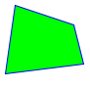




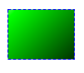
QPainter Paint Toolkit
Draw different shapes
Polygon, rectangle, ellipse, pie, line, arc, text
Specify pen width and style
Solid, dash (slow), dot, join style
Enable/disable antialiasing
Antialiasing is slow
Set brush
No brush, gradient color, texture
Use transformations
Translate, rotate (n x 90 degrees is fast), scale, shear
Save and restore drawing context
QPainter settings

Slide 79
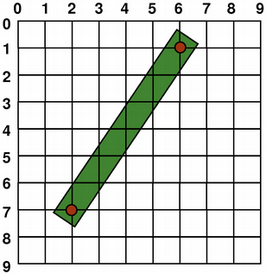
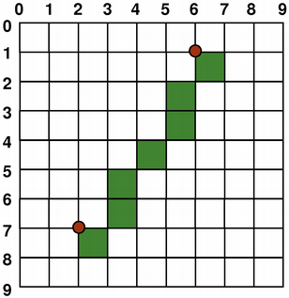
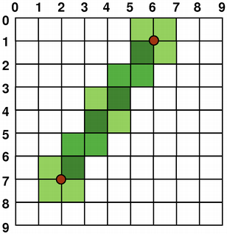
Coordinate System - Surface to Render
Controlled by QPainter
Origin: Top-Left • Rendering
Logical-mathematical
Aliased-right and below
Anti-aliased-smoothing
Rendering quality switch
QPainter::setRenderHint()

Slide 80
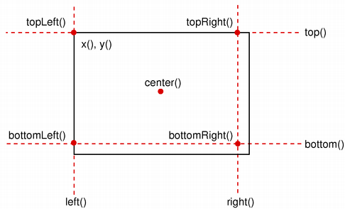
Geometry Helper Classes
QSize(w,h)
scale, transpose
QPoint(x,y)
QLine(point1, point2)
translate, dx, dy
QRect(point, size)
adjust, move
translate, scale, center
QSize size(100,100);
QPoint point(0,0);
QRect rect(point, size);
rect.adjust(10,10,-10,-10);
QPoint center = rect.center();

Slide 81
Color Handling

Slide 82
Creating Color Values
Using different color models:
QColor(255,0,0) // RGB
QColor::fromHsv(h,s,v) // HSV
QColor::fromCmyk(c,m,y,k) // CMYK
Defining colors:
QColor(255,0,0); // red in RGB
QColor(255,0,0, 63); // red 25% opaque (75% transparent)
QColor("#FF0000"); // red in web-notation
QColor("red"); // by svg-name
Qt::red; // predefined Qt global colors
Many powerful helpers for manipulating colors
QColor("black").lighter(150); // a shade of gray
QColor always refers to device color space

Slide 83
Drawing Lines and Outlines with QPen
A pen (QPen) consists of:
A color or brush
A width
A style (e.g. NoPen or SolidLine)
A cap style (i.e. line endings)
A join style (connection of lines)
Activate with QPainter::setPen()
QPainter painter(this);
QPen pen = painter.pen();
pen.setBrush(Qt::red);
pen.setWidth(3);
painter.setPen(pen);
// draw a rectangle with 3 pixel width red outline
painter.drawRect(0,0,100,100);

Slide 84
The Outline
Rule: The outline equals the size plus half the pen width on each side.
For a pen of width 1:
QPen pen(Qt::red, 1); // width = 1
float hpw = pen.widthF()/2; // half-pen width
QRectF rect(x, y, width, height);
QRectF outline = rect.adjusted(-hpw, -hpw, hpw, hpw);
Due to integer rounding on a non-antialiased grid, the outline is shifted by 0.5 pixel towards the bottom right.
ex-rectoutline

Slide 85

Filling Shapes with QBrush
QBrush defines fill pattern of shapes
Brush configuration
setColor(color)
setStyle(Qt::BrushStyle)
NoBrush, SolidPattern,…
QBrush(gradient) // QGradient's
setTexture(pixmap)
Brush with solid red fill
painter.setPen(Qt::red);
painter.setBrush(QBrush(Qt::yellow, Qt::SolidPattern));
painter.drawRect(rect);

Slide 86
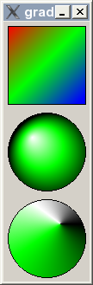
Drawing Gradient Fills
Gradients used with QBrush
Gradient types
QLinearGradient
QConicalGradient
QRadialGradient
Gradient from P1(0,0) to P2(100,100)
QLinearGradient gradient(0, 0, 100, 100);
// position, color: position from 0..1
gradient.setColorAt(0, Qt::red);
gradient.setColorAt(0.5, Qt::green);
gradient.setColorAt(1, Qt::blue);
painter.setBrush(gradient);
// draws rectangle, filled with brush
painter.drawRect(0, 0, 100, 100 );
ex-gradients

Slide 87
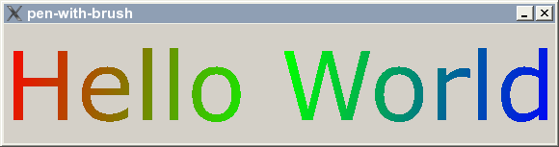
Brush on QPen
Possible to set a brush on a pen
Strokes generated will be filled with the brush
ex-pen-with-brush

Slide 88
Creating Color Values
Supported color spaces
QColor(255,0,0) // RGB
QColor::fromHsv(h,s,v) // HSV
QColor::fromCmyk(c,m,y,k) // CMYK
Defining Colors
QColor(255,0,0); // red in RGB
QColor(255,0,0, 127); // red 50% transparent
QColor("#FF0000"); // red in web-notation
QColor("red"); // by svg-name
Qt::red; // predefined Qt global colors
QColor powerful for manipulating colors
QColor("red")::lighter(150); // defines 50% brighter red
ex-alpha-blending

Slide 89
Color Themes and Palettes
To support widgets color theming
setColor(blue) not recommended
Colors need to be managed
QPalette manages colors
Consist of color groups
enum QPalette::ColorGroup
Resemble widget states
QPalette::Active
Used for window with keyboard focus
QPalette::Inactive
Used for other windows
QPalette::Disabled
Used for disabled widgets

Slide 90
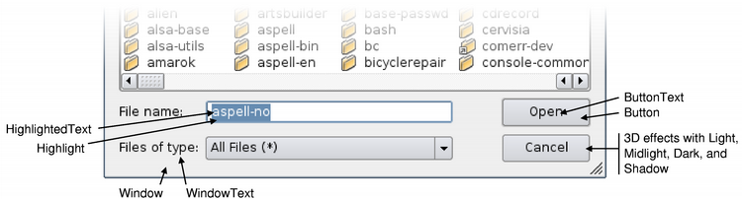
Color Groups and Roles
Color group consists of color roles
enum QPalette::ColorRole
Defines symbolic color roles used in UI
QPalette pal = widget->palette();
QColor color(Qt::red);
pal.setColor(QPalette::Active, QPalette::Window, color);
// for all group
pal.setBrush(QPalette::Window, QBrush(Qt::red));
widget->setPalette(pal);
QApplication::setPalette()
Sets application wide default palette

Slide 91
Painting Operations

Slide 92
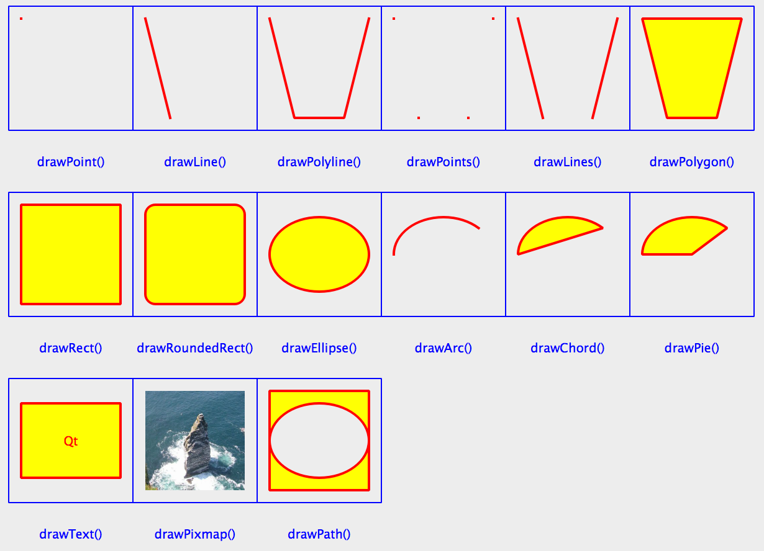
Drawing Figures
Painter configuration
Pen width: 2
Pen color: red
Font size:10
Brush color: yellow
Brush style: solid
ex-figures

Slide 93
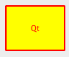
Drawing Text
QPainter::drawText(rect, flags, text)
QPainter painter(this);
painter.drawText(rect, Qt::AlignCenter, tr("Qt"));
painter.drawRect(rect);
painter.drawStaticText(left, top, staticText);
QFontMetrics
Calculate size of strings
QFont font("times", 24);
QFontMetrics fm(font);
nt pixelsWide = fm.width("Width of this text?");
int pixelsHeight = fm.height();

Slide 94
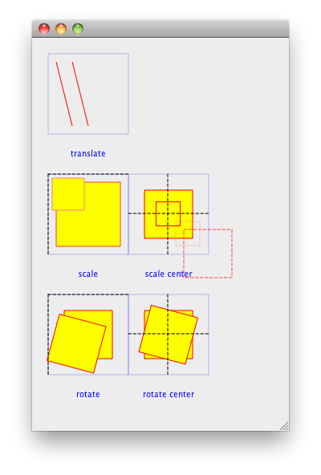
Transformation
Manipulating the coordinate system
translate(x,y)
scale(sx,sy)
rotate(a)
shear(sh,sv)
reset()
ex-transform

Slide 95
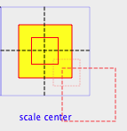
Transform and Center
scale(sx,sy)
Scales around QPoint(0,0)
Same applies to all transform operations
Scale around center?
painter.drawRect(r);
painter.translate(r.center());
painter.scale(sx,sy);
painter.translate(-r.center());
// draw center-scaled rect
painter.drawRect(r);
ex-transform

Slide 96

Painter Path - QPainterPath
Container for painting operations
Enables reuse of shapes
QPainterPath path;
path.addRect(20, 20, 60, 60);
path.moveTo(0, 0);
path.cubicTo(99, 0, 50, 50, 99, 99);
path.cubicTo(0, 99, 50, 50, 0, 0);
painter.drawPath(path);
Path information
controlPointRect() – rect containing all points
contains() – test if given shape is inside path
intersects() – test given shape intersects path
ex-house-drawings

Slide 97
Painting and Widget Attributes
Control the widget behavior – in some cases affecting the performance as well
Especially in embedded platforms
Qt::WA_NoSystemBackground – may be useful in embedded platforms for the top-level widget, which is considered to be opaque
Qt::WA_OpaquePaintEvent – no need to clear widget’s background
Qt::WA_TranslucentBackground – non-opaque regions of a widget are translucent
Easy way to paint arbitrary shaped widgets
This requires also a window flag Qt::FramelessWindowHint
Qt::WA_DeleteOnClose – deletes a widget after the widget has accepted closeEvent()
Easy way to delete dynamically created dialogs
ex-translucent-clock

Slide 98
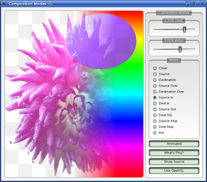
Other Painter Concepts
Clipping
Clip drawing operation to shape
Composition modes:
Rules for digital image compositing
Combining pixels from source to destination
Rubber Bands – QRubberBand
Rectangle or line that indicate selection or boundary

Slide 99
Paint Operations and Performance
Slow CPU-intensive operations
Rotations (not multiple of 90 degrees), non-linear gradients with three or more colors, dashed lines, anti-aliasing, text layout calculation, image composition (except source and source over modes), non-rectangular clip with complex transformations, painter path fill calculations
CPU-intensive operations typically result that the application uses most of the time in qtbase/src/gui/painting/qdrawhelper.cpp
If this is not the case, performance problem is likely somewhere else
Good way to improve paint performance is to paint to QPixmaps and render the pixmaps
Pixmap blending may still drop the performance to a few frames even in desktop CPUs

Slide 100
QImage vs. QPixmap
Designed and optimized for I/O
Direct pixel access and manipulation
Hardware-independent (unlike QPixmap)
Supports multiple image formats
E.g. RGB32, ARGB32, ARGB32_Premultiplied, and so on
Can be used for drawing in a worker thread
Draw you picture gallery application’s images onto QImages in another thread, and
Send finished images to the GUI thread (signal) to be drawn as QPixmaps
Designed and optimized for showing images on the screen
In your custom widget you can use QPainter::drawPixmap()
Implementation might also depend on the underlying hardware/graphics subsystem
Can be created using static convenience functions (in addition to constructors)
QPixmap::grabWidget()
QPixmap::grabWindow()
ex-image-raycasting, ex-pixmap-puzzle

Slide 101



Image Transformations
QImage provides multiple utility functions for image manipulation
Some of these are available for QPixmaps as well, although they operate less efficiently
For image transparency, use QPainter composition modes or the QGraphicsOpacityEffect class
Using composition modes is the most efficient choice
Inverting pixels
void QImage::invertPixels()
Mirroring
QImage QImage::mirrored(bool horizontal = false, bool vertical = true) const

Slide 102
Image Transformations
Color swapping
Red and blue colors are exchanged
An RGB image becomes a ”BGR” rendering of the original
QImage QImage::rgbSwapped()
Masking
Image appears to be irregularly shaped (i.e. non-rectangular)
QImage QImage::createAlphaMask()
QImage QImage::createHeuristicMask()
QImage QImage::createMaskFromColor()

Slide 103

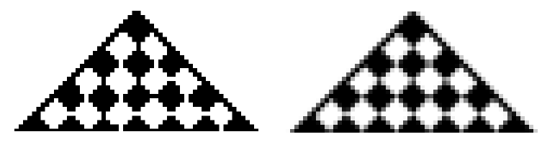
Image Transformations
Scaling
QImage QImage::scaled()
QImage QImage::scaledToWidth()
QImage QImage::scaledToHeight()
Two transformation modes available for scaling
Qt::FastTransformation (example on the left)
Qt::SmoothTransformation (example on the right)
Can you to tell the difference? How about when zoomed?
Zoomed

Slide 104
3D Painting
Use QOpenGLWidget, QOpenGLWindow, QVulkanWindow
QOpenGLWidget allows using QPainter (and OpenGL) in painting the widget
Supports rendering and rendering back off-screen content
Windows have no dependencies on widgets, but can be used in a widget application with QWidget::createWindowContainer()
Actually, plenty of other ways to use 3D
Qt Quick
Shaders
Qt 3D
Qt Data Visualization
More details in 3D Edition

Slide 105
QOpenGLWidget vs. QOpenGLWindow
Similar APIs in both classes
initializeGL() – initialize your resources
resizeGL() – set the viewport or projection, when window size changes
paintGL() – render
Both render to FBO
Both supports partial rendering with QPainter
Function update() will request for a repaint – paintGL() function called
OpenGL context created automatically and made current

Slide 106
QOpenGLWindow vs. QVulkanWindow
Both windows need a rendering surface
Define a surface format, set the format to
OpenGL window renders to a surface using OpenGL context
Vulkan window renders to a surface using a Vulkan instance

Slide 107
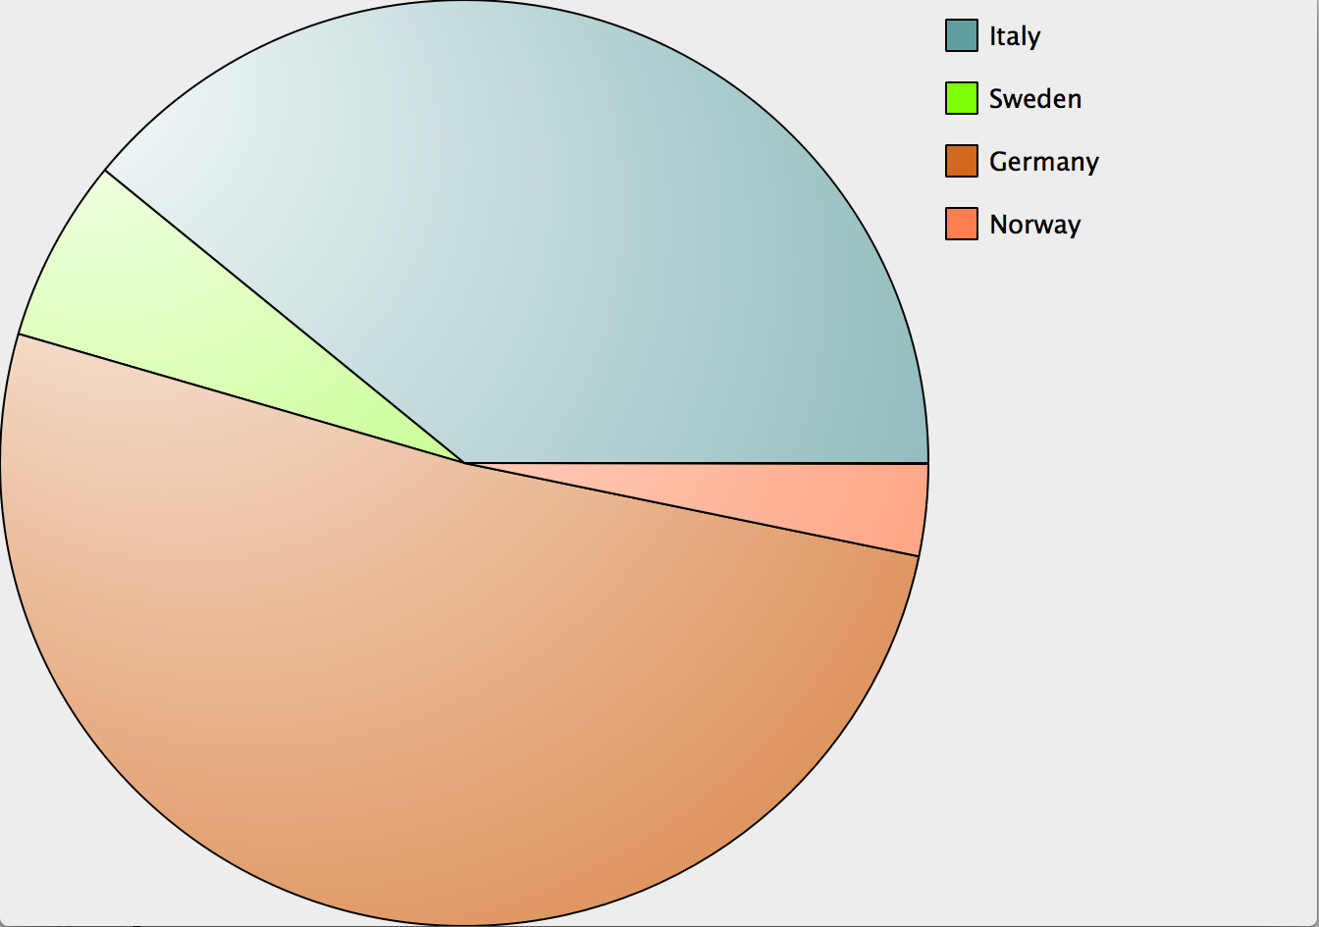
Lab – Pie Chart Widget
Task to implement a pie chart
Draw pies with painters based on data.
Data Example: Population of 4 countries
Sweden
Germany
Norway
Italy
Guess the population in millions of citizens ;-)
Legend is optional
See lab description for details
lab-piechart

Slide 108
Styles and Style Sheets

Slide 109
Styled Painting
Native widgets use QStyle and QPalette for painting
Platform-dependent style
You can assign your own style to the application
Style Sheets
Fine grained control over the look of application
Easily applied using style sheets in CSS format
void QPushButton::paintEvent(QPaintEvent *)
{
QStylePainter p(this);
QStyleOptionButton option;
initStyleOption(&option);
p.drawControl(QStyle::CE_PushButton, option);
}

Slide 110
Using Styles
You may customize the style used by existing widgets
To have a company brand, for example
Styles may be used in custom widgets to provide native look-and-feel
Allows also easy adaptation to custom styles later on
void CoolCustomWidget::paintEvent(QPaintEvent *event)
{
QStyleOptionFocusRect option;
option.initFrom(this);
option.backgroundColor = palette().color(QPalette::Background);
style()->drawPrimitive(QStyle::PE_FrameFocusRect, &option, &p, this);

Slide 111
QStyle
The widgets call QStyle methods for:
drawing
querying metrics (sizes and positions inside the widget)
general look and feel “style hints”
preparing a widget to be styled
QStylePainter provides a QStyle API
Uses shorter argument list as QStyle, no need to pass QPainter and QWidget in every function call
drawComplexControl(QStyle::ComplexConrtol, QStyleOptionComplex)
drawControl(QStyle::ConrtolElement, QStyleOption)
drawPrimitive(QStyle::PrimitiveElement, QStyleOption)
The style does not change the real behavior of the widget, only its appearance and GUI details of the user interface

Slide 112
QCommonStyle
Inherits QStyle directly
Implements some of the widget's look and feel that is common to all GUI styles
Implementation is partially abstract, and does not provide a ready to use style as a basis
You need to subclass QCommonStyle to create a usable style
You may need to do a lot of customization in your style class to make a nice style

Slide 113
QProxyStyle
QProxyStyle wraps QStyle-based class to dynamically override style behaviour
Common styles in Qt delegate the operation to the proxy style if it is installed
If the platform controls how some UI components are drawn, proxy() will not be called
For example, Mac controls how menus are drawn
case CE_PushButton:
if (const QStyleOptionButton *btn = qstyleoption_cast<const
QStyleOptionButton *>(opt)) {
proxy()->drawControl(CE_PushButtonBevel, btn, p, widget);
QStyleOptionButton subopt = *btn;
subopt.rect = subElementRect(SE_PushButtonContents, btn, widget);
proxy()->drawControl(CE_PushButtonLabel, &subopt, p, widget);
….
}

Slide 114
Typical Style Class Diagram

Slide 115
High-Level Flowchart

Slide 116
Writing Your Own QStyle
QStyle is only the API (virtual methods and helpers), QCommonStyle is a useful base class for many styles
For a new style, inherit QCommonStyle or an existing style:
For testing:
QApplication::instance()->setStyle(new TestStyle);
#include <qwindowsstyle.h>
class TestStyle : public QWindowsStyle
{
public:
virtual int styleHint(StyleHint sh, const QStyleOption *opt=0,
const QWidget *w=0, QStyleHintReturn* ret=0) const;
};

Slide 117
Setting Palette in a Style
QStyle offers several methods to modify palette
standardPalette()
Some systems (Windows, Mac) use platform specific themes to set palette
In this case, the standardPalette() method is not used
Use polish() to set style specific palette to ensure it will be set on all platforms
polish(QPalette *)
Called when the style is activated

Slide 118
The polish() Method
polish(QApplication*) - called once on when the style is applied
Installing global event filters
Fixing font for the needs of the style
polish(Qpalette*)- called when style changes
Fixing the palette for the purposes of the style
polish(QWidget*) - called for every widget when style changes
setBackgroundRole()for pixmap backgrounds
setAttribute() (e.g. WA_Hover so that the widget is repainted when the mouse enters or leaves the widget)
Installing event filters on a widget (e.g. for setting a mask for non-rectangular widgets when resized)
void TestStyle::polish(QWidget *w)
{
if (qobject_cast<QPushButton *>(w)) {
w->setAttribute(Qt::WA_Hover);
}
QWindowsStyle::polish(w);
}

Slide 119
The styleHint() Method
Styles can re-implement styleHint()to set general hints such as:
SH_UnderlineShortcut - whether shortcuts are underlined
SH_Button_FocusPolicy - the default focus policy for buttons
SH_TabBar_Alignment - alignment for tabs in a QTabWidget
SH_LineEdit_PasswordCharacter - the character to be used for passwords
Most of the big amount of enumeration values are not currently used
int TestStyle::styleHint(StyleHint sh, const QStyleOption *opt,
const QWidget *w, QStyleHintReturn *hret) const
{
switch (sh) {
case SH_GroupBox_TextLabelVerticalAlignment:
return Qt::AlignVCenter;
default:
return QWindowsStyle::styleHint(sh,opt,w,hret);
}
}

Slide 120
Control Element Hierarchy

Slide 121
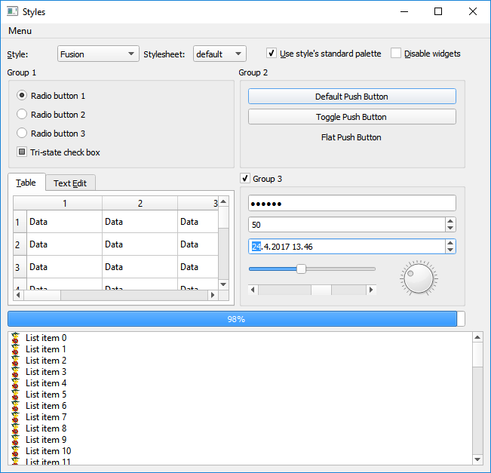
Key Players in QStyle Hierarchy
Primitive element
Passive elements
Common to several widgets
Arrows, scroll bar and combo box frames
Always a part of a larger construct. Cannot exist on its own
Control element
Performs an action or displays information
Tab bar tabs, check boxes, progress bars
Use SubElements to calculate bounding rectangles
Complex control
Composed of controls, like sliders, indicators
Behave differently depending on user interaction:, e.g.
scroll bar slider moves up/down with mouse
Use SubControls define the constituting controls

Slide 122
Size and Position
SubElement
Define size and position for passive sub-parts of a widget
Button bounding rectangle, progress bar content area etc.
SubControl
Define size and position for active parts of a ControlElement
Title bar buttons, combo box frame and arrows, spin box up/down arrows etc.
PixelMetric
Style dependent size for various UI elements
Spacing in layouts, item spacing in lists etc, generic icon sizes etc.

Slide 123
Draw Method Signature
The virtual drawing related methods have following parameters in their signature
ComplexControl/ControlElement/PrimitiveElement enumeration defining the graphical element to be drawn
QStyleOption object defining how the element is drawn
QPainter object to draw the element
Optional QWidget handle on which the drawing is performed
The style should not expect that the handle exists
This mechanism allows drawing a widget without linking to the widget code

Slide 124
QStyleOption
QStyleOption groups/stores many parameters, used by QStyle functions, into a single struct:
rect - the widget rectangle
palette - the widget palette
state - the widget state (enabled, has focus, mouse over, sunken, raised etc.)
direction – layout direction
fontMetrics
QStyleOption subclasses provide other widget-specific parameters:
QStyleOptionButton - pushbutton features (flat, default etc.), text and icon
QStyleOptionComboBox - whether the combobox is editable, the rectangle of the popup
You may sub-class QStyleOption and extend the enumeration after QStyleOption::SO_CustomBase
You may obviously re-implement drawPrimitive() method and ignore/change all style data there

Slide 125
Multiple Levels of Method Calls
High-level drawing methods delegate the work to lower-level ones
For instance QCommonStyle::drawControl(), for a CE_PushButton, calls
drawControl(CE_PushButtonBevel) for the border (bevel),
drawControl(CE_PushButtonLabel) for the text label and icon,
drawPrimitive(PE_FrameFocusRect) for the focus rectangle
Similarly, CE_ProgressBar calls CE_ProgressBarGroove, CE_ProgressBarContents and CE_ProgressBarLabel
Override only the methods & case statements that you need
It is not always straightforward to figure out where to change

Slide 126
The drawControl() Method
drawControl() draws a “control element” (part of a widget that performs some action or displays information to the user)
ControlElement is an enum, for example:
CE_PushButton - push button bevel and label
CE_PushButtonBevel - the border of a push button
CE_CheckBox - checkbox
CE_Splitter - splitter handle
CE_TabBarTab - tab shape and label within a QTabBar
CE_TabBarTabShape - tab shape within a QTabBar
CE_TabBarTabLabel - label within a tab

Slide 127
Implementing drawControl()
void TestStyle::drawControl(ControlElement ce,
const QStyleOption *opt, QPainter *p, const QWidget *w) const
{
switch(ce) {
case CE_PushButtonBevel:
// Need to adjust the rect for the bottom and right lines
// be visible inside the rectangle, see QPainter documentation
p->drawRect(opt->rect.adjusted(0,0,-1,-1));
break;
default:
QWindowsStyle::drawControl(ce, opt, p, w);
}
}

Slide 128
The drawPrimitive() Method
Called for drawing a common GUI element, possibly used by several controls
PrimitiveElement is an enum with many PE_* values:
PE_FrameFocusRect - Generic focus indicator
PE_IndicatorArrowUp - Generic Up arrow
PE_IndicatorCheckBox - On/off indicator, e.g. QCheckBox
PE_IndicatorBranch - Branches of a tree in a tree view
PE_IndicatorMenuCheckMark - Check mark used in a menu
PE_FrameLineEdit - Panel frame for line edits

Slide 129
Drawing Helper Functions
Drawing utilities defined in qdrawutil.h, for use from style code
qDrawShadeLine() - horizontal or vertical shaded line
qDrawShadeRect() - shaded rectangle
qDrawShadePanel() - shaded panel, either raised or sunken
qDrawWinButton() - Windows-style (2 pixels line width) button, raised or sunken
qDrawWinPanel() - Windows-style (2 pixels line width) panel, raised or sunken (for line edits, check boxes, etc.)
qDrawPlainRect() - plain rectangle, with line width and fill

Slide 130
The pixelMetric() Method
A pixel metric is a style-dependent size represented as a single pixel value
Logical pixel values and they get scaled in high DPI displays
Styles re-implement the virtual method int QStyle::pixelMetric(PixelMetric metric, const QStyleOption *option = 0, const QWidget *widget = 0)
PM_ButtonMargin - margin inside push button
PM_IndicatorWidth/Height - width/height of check box
PM_Menu* - metrics used for menus
PM_Slider* - metrics used for sliders
PM_ScrollBar* - metrics used for scrollbars
PM_TabBar* - metrics used for tab bars

Slide 131
QStylePainter
A convenience class for drawing QStyle elements
Makes parameter lists shorter and easier
void MyWidget::paintEvent(QPaintEvent * /* event */)
{
QPainter painter(this);
QStyleOptionFocusRect option;
option.initFrom(this);
option.backgroundColor = palette().color(QPalette::Background);
style()->drawPrimitive(QStyle::PE_FrameFocusRect, &option, &painter, this);
}
void MyWidget::paintEvent(QPaintEvent * /* event */)
{
QStylePainter painter(this);
QStyleOptionFocusRect option;
option.initFrom(this);
option.backgroundColor = palette().color(QPalette::Background);
painter.drawPrimitive(QStyle::PE_FrameFocusRect, option);
}

Slide 132
QStylePlugin
A simple Qt plugin interface that makes it easy to load custom styles dynamically into applications
Create a style and make it available for all applications
class MyStylePlugin : public QStylePlugin
{
Q_OBJECT
Q_PLUGIN_METADATA(IID "org.qt-project.Qt.QStyleFactoryInterface" FILE ”mystyleplugin.json")
public:
MyStylePlugin(QObject *parent = 0);
QStyle *create(const QString &key);
};
QStyle *MyStylePlugin::create(const QString &key)
{
if (key.compare(“MyStyle”) == 0)
return new MyStyle;
else
return 0;
};

Slide 133
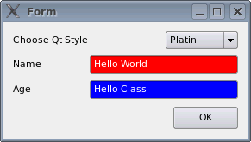
Qt Style Sheets
Used to customize the appearance of widgets
Similar to CSS style sheets but adapted to widgets
Allows all kinds of customizations that are difficult or impossible using QPalette
Palette definitions may be overridden by the platform
QStyle overrides palette definitions
Sheets definitions are guaranteed to be used
Ideal for minor customizations to existing widgets
Style sheets can override widget style (QStyle)
May be application- or widget-specific
QApplication::setStyleSheet()
QWidget::setStyleSheet()
ex-simple-qss

Slide 134
CSS Rules
selector { property : value; property : value }
Selector: specifies the widgets
Property/value pairs: specify properties to change.
QPushButton { color: red; background-color: white }
Examples of stylable elements
Colors, fonts, pen style, alignment.
Background images.
Position and size of sub controls.
Border and padding of the widget itself.
Look at Qt Style Sheets Reference Documentation

Slide 135
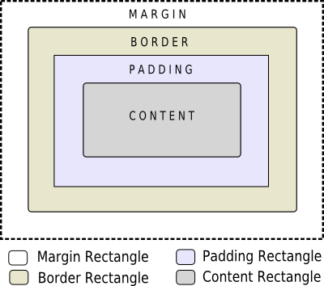

The Box Model
Every widget treated as box
Four concentric rectangles
Margin, Border, Padding, Content
Customizing QPushButton
QPushButton {
border-width: 2px;
border-radius: 10px;
padding: 6px;
// ...
}
By default, margin, border-width, and padding are 0

Slide 136
Selector Types
*{ } // Universal selector
All widgets
QPushButton { } // Type Selector
All instances of class
.QPushButton { } // Class Selector
All instances of class, but not subclasses
QPushButton#objectName // ID Selector
All Instances of class with objectName
QDialog QPushButton { } // Descendant Selector
All instances of QPushButton which are children of QDialog
QDialog > QPushButton { } // Direct Child Selector
All instances of QPushButton which are direct children of QDialog
QPushButton[enabled="true"] // Property Selector
All instances of class which match property

Slide 137
Selector Details
Property Selector
If property changes it is required to re-set style sheet
Combining Selectors
QLineEdit, QComboBox, QPushButton { color: red }
Pseudo-States
Restrict selector based on widget’s state
Example: QPushButton:hover {color:red}
Selecting Subcontrols
Access subcontrols of complex widgets as QComboBox, QSpinBox, ...
QComboBox::drop-down { image: url(dropdown.png) }
Subcontrols positioned relative to other elements
Change using subcontrol-origin and subcontrol-position
ex-qss-selector

Slide 138
Conflict Resolution - Cascading
Effective style sheet obtained by merging
Widgets’s ancestor (parent, grandparent, etc.)
Application stylesheet
On conflict: widget own style sheet preferred
qApp->setStyleSheet("QPushButton { color: white }");
button->setStyleSheet("* { color: blue }");
Style on button forces button to have blue text
In spite of more specific application rule
ex-qss-cascading

Slide 139
Conflict Resolution - Selector Specifity
Conflict: When rules on same level specify same property
Specificity of selectors apply
QPushButton:hover { color: white }
QPushButton { color: red }
Selectors with pseudo-states are more specific
Calculating selector’s specificity
a Count number of ID attributes in selector
b Count number of property specifications
c Count number of class names
Concatenate numbers a-b-c. Highest score wins
If rules scores equal, use last declared rule
QPushButton {} /* a=0 b=0 c=1 -> specificity = 1 */
QPushButton#ok {} /* a=1 b=0 c=1 -> specificity = 101 */
Demo: painting/ex-qssconflict
ex-qss-conflict

Slide 140
Style Sheet Class Diagram

Slide 141
QStyleSheetStyle
Gets instantiated when a style sheet is set with Qapplication::setStyleSheet()
If the application has already a stylesheet, setting a QStyle-based style will keep a QStyleSheetStyle object the active style object
Stylesheet, if set, is always applied first!
Derived from QWindowsStyle
Usually, drawing is delegated to base style if the class does not handle an element
A couple of elements let QWindowsStyle do the draw
CC_GroupBox
Control elements of checkboxes
Primitive elements of PE_PanelButtonTool and PE_PanelButtonCommand
Many enums of subElementRect(), mainly SE_ItemViewItem* SE_TabBarTab* and SE_CheckBox*
Applying your custon style on top of a style sheet might be problematic!

Slide 142
Can Style Sheets And QStyle Co-exist?
Internally, QStyleSheetStyle(QStyle *baseStyle) is used to initialize the style
If you have set your own style, it becomes the base style
Drawing methods in QstyleSheetStyle often check does it need to draw the element, or can the base class do it
If your style sheet does not set any of the properties, which mandate that QstyleSheetStyle has to be used, methods in your style are called
Requires manual checking of how drawing path will be determined
bool baseStyleCanDraw() const {
if (!hasBackground() || (background()->brush.style() == Qt::NoBrush && bg->pixmap.isNull()))
return true;
if (bg && !bg->pixmap.isNull())
return false;
if (hasGradientBackground())
return features & StyleFeature_BackgroundGradient;
return features & StyleFeature_BackgroundColor;
}

Slide 143
Can Style Sheets And QStyle Co-exist?
Implement what you can with style sheets
Reimplement properties that conflict with your QStyle. You can try
Remove properties from style sheet that cause QStyle methods not to be called, and implement the functionality in your style class
Implement whole widget from style sheet with your own style
It is not guaranteed that QStyleSheetStyle implementation will stay the same in future versions of Qt
Your style might break if switching to a newer version of Qt
Not a very probable scenario, though

Slide 144
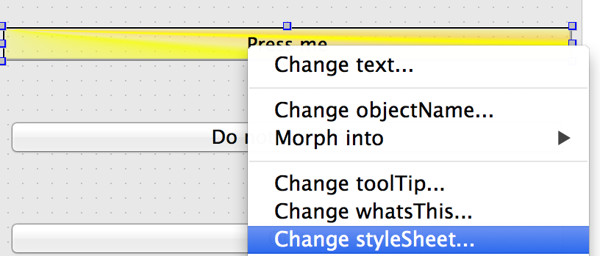
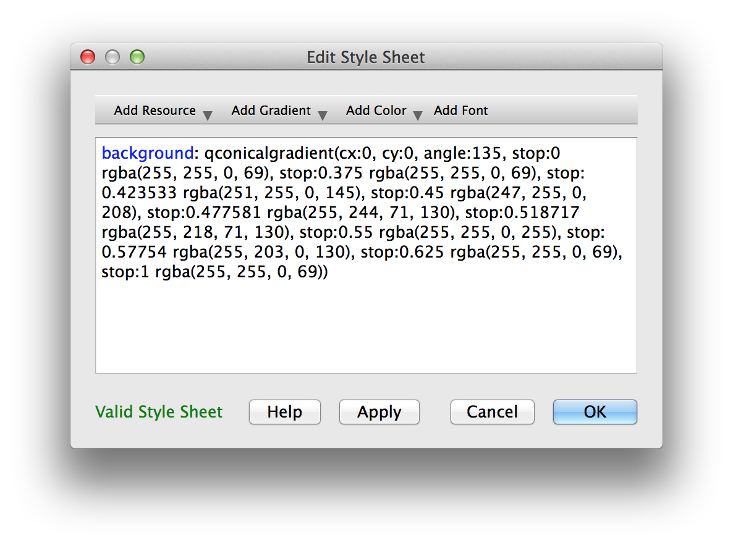
Qt Designer Integration
Excellent tool to preview style sheets
Right-click on any widget
Select Change styleSheet..
Includes syntax highlighter and validator

Slide 145
Questions and Answers
Describe the Qt paint path at the high level.
What is the role of the paint device?
What kind of paint device classes does Qt have?
What is QWindow? How is it related to QWidget?
What kind of paint function QPainter has?
You want to use GPU to accelerate QPainter drawing? Is it possible? If it is, how to accelerate the painting?
How widgets can be styled?
How widgets are styled with style sheets?

Slide 146
Summary
QPainter provides a 2D paint toolkit supporting
Pen and brush settings
Transformations
Gradient colors
Image composition
QPainter can be used to paint to any paint device (widget, image, opengl frame buffer object)
Paint devices use different paint engines
Paint engine converts all or some QPainter paint primitives to device-specific primitives
QPainter => OpenGL

Slide 147
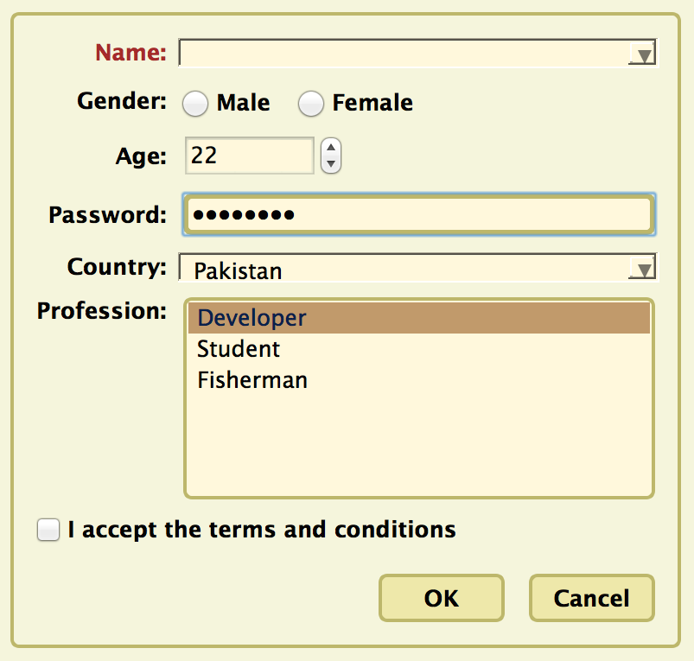
Lab – Project Task
Tasks (in QtCreator Welcome mode, look for ‘Style Sheet Example’)
Investigate style sheet
Modify style sheet
Remove style sheet
and implement your own
Example does not save changes
Use designer for this.
Edit style sheet using
File -> Edit StyleSheet

Slide 148
Application Creation

Slide 149
Contents
Main Windows
Settings
Resources
Translation for Developers
Deploying Qt Applications

Slide 150
Objectives
We will create an application to show fundamental concepts
Main Window: How a typical main window is structured
Settings: Store/Restore application settings
Resources: Adding icons and other files to your application
Translation: Short overview of internationalization
Deployment: Distributing your application

Slide 151
Main Windows

Slide 152
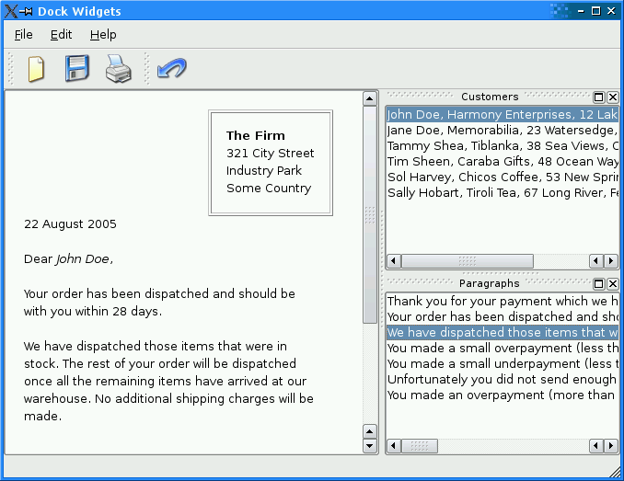
Typical Application Ingredients
Main window with
Menu bar
Tool bar, Status bar
Central widget
Often a dock window
Settings (saving state)
Resources (e.g icons)
Translation
Load/Save documents
Not a complete list

Slide 153
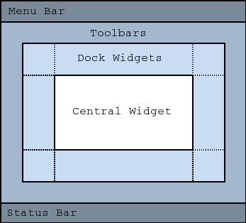
Main Window
QMainWindow: main application window
Has own layout
Central Widget
QMenuBar
QToolBar
QDockWidget
QStatusBar
Central Widget
QMainWindow::setCentralWidget( widget )
Just any widget object
ex-main-window

Slide 154
Creating Actions - QAction
Action is an abstract user interface command
Emits signal triggered on execution
Connected slot performs action
Added to menus, toolbar, key shortcuts
Each performs same way
Regardless of user interface used
void MainWindow::setupActions() {
QAction* action = new QAction(tr("Open ..."), this);
action->setIcon(QIcon(":/images/open.png"));
action->setShortcut(QKeySequence::Open);
action->setStatusTip(tr("Open file"));
connect(action, SIGNAL(triggered()), this, SLOT(onOpen()));
menu->addAction(action);
toolbar->addAction(action);

Slide 155
QAction Capabilities
setEnabled(bool)
Enables disables actions
In menu and toolbars, etc...
setCheckable(bool)
Switches checkable state (on/off)
setChecked(bool) toggles checked state
setData(QVariant)
Stores data with the action

Slide 156

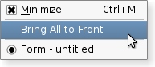
Create Menu Bar
QMenuBar: a horizontal menu bar
QMenu: represents a menu
Indicates action state
QAction: menu items added to QMenu
void MainWindow::setupMenuBar() {
QMenuBar* bar = menuBar();
QMenu* menu = bar->addMenu(tr("&File"));
menu->addAction(action);
menu->addSeparator();
QMenu* subMenu = menu->addMenu(tr("Sub Menu"));
…

Slide 157
Creating Toolbars - QToolBar
Movable panel…
Contains set of controls
Can be horizontal or vertical
QMainWindow::addToolbar( toolbar )
Adds toolbar to main window
QMainWindow::addToolBarBreak()
Adds section splitter
QToolBar::addAction( action )
Adds action to toolbar
QToolBar::addWidget(widget)
Adds widget to toolbar
void MainWindow::setupToolBar() {
QToolBar* bar = addToolBar(tr("File"));
bar->addAction(action);
bar->addSeparator();
bar->addWidget(new QLineEdit(tr("Find ...")));

Slide 158
QToolButton
Quick-access button to commands or options
Used when adding action to QToolBar
Can be used instead QPushButton
Different visual appearance!
Advantage: allows to attach action
QToolButton* button = new QToolButton(this);
button->setDefaultAction(action);
// Can have a menu
button->setMenu(menu);
// Shows menu indicator on button
button->setPopupMode(QToolButton::MenuButtonPopup);
// Control over text + icon placements
button->setToolButtonStyle(Qt::ToolButtonTextUnderIcon);

Slide 159
The Status Bar - QStatusBar
Horizontal bar
Suitable for presenting status information
showMessage( message, timeout )
Displays temporary message for specified milli-seconds
clearMessage()
Removes any temporary message
addWidget()or addPermanentWidget()
Normal, permanent messages displayed by widget
void MainWindow::createStatusBar() {
QStatusBar* bar = statusBar();
bar->showMessage(tr("Ready"));
bar->addWidget(new QLabel(tr("Label on StatusBar")));

Slide 160
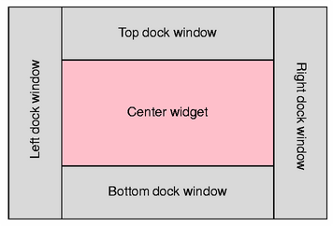
Creating Dock Windows - QDockWidget
Window docked into main window
Qt::DockWidgetArea enum
Left, Right, Top, Bottom dock areas
QMainWindow::setCorner(corner, area)
Sets area to occupy specified corner
QMainWindow::setDockOptions(options)
Specifies docking behavior (animated, nested, tabbed,...)
void MainWindow::createDockWidget() {
QDockWidget *dock = new QDockWidget(tr("Title"), this);
dock->setAllowedAreas(Qt::LeftDockWidgetArea);
QListWidget *widget = new QListWidget(dock);
dock->setWidget(widget);
addDockWidget(Qt::LeftDockWidgetArea, dock);

Slide 161
QMenu and Context Menus
Launch via event handler
void MyWidget::contextMenuEvent(event) {
m_contextMenu->exec(event->globalPos());
Or signal customContextMenuRequested()
Connect to signal to show context menu
Or via QWidget::actions() list
QWidget::addAction(action)
setContextMenuPolicy(Qt::ActionsContextMenu)
Displays QWidget::actions() as context menu

Slide 162
Typical APIs
QWidget
setWindowModified(...)
setWindowTitle(...)
addAction(...)
contextMenuEvent(...)
QMainWindow
setCentralWidget(...)
menuBar()
statusBar()
addToolbar(...)
addToolBarBreak()
addDockWidget(...)
setCorner(...)
setDockOptions(...)
QAction
setShortcuts(...)
setStatusTip(...)
signaltriggered()
QMenuBar
addMenu(...)
QToolbar
addAction(...)
QStatusBar
showMessage(...)
clearMessage()
addWidget(...)

Slide 163
Lab – Text Editor
Create a text editor with
load, save, quit
About and AboutQt
A QPlainTextEdit serves for editing the text.
Optional:
Show whether the file is dirty
Ask the user whether to save if file is dirty when application quits
Make sure also to ask when window is closed via window manager
Show the cursor position in the status bar
Position is determined by cursors block and column count
lab-text-editor

Slide 164
Settings

Slide 165
Persistent Settings - QSettings
Configure QSettings
QCoreApplication::setOrganizationName("MyCompany");
QCoreApplication::setOrganizationDomain("mycompany.com");
QCoreApplication::setApplicationName("My Application");
Typical usage
QSettings settings;
settings.setValue("group/value", 68);
int value = settings.value("group/value").toInt();

Slide 166
Settings Values
Values are stored as QVariant
Keys form hierarchies using '/’
Or use beginGroup(prefix) / endGroup()
value() excepts default value
settings.value("group/value", 68).toInt()
If value not found and default not specified
Invalid QVariant() returned

Slide 167
Restoring State of an Application
Store geometry of application
Restore geometry of application
void MainWindow::writeSettings() {
QSettings settings;
settings.setValue("MainWindow/size", size());
settings.setValue("MainWindow/pos", pos());
}
void MainWindow::readSettings() {
QSettings settings;
settings.beginGroup("MainWindow");
resize(settings.value("size", QSize(400, 400)).toSize());
move(settings.value("pos", QPoint(200, 200)).toPoint());
settings.endGroup();
}

Slide 168
Settings - Behind the Scenes
QSettings is re-entrant
Same file can be accessed from any number of threads (processes)
Each thread has its own instance
If QSettings in one thread set new data values, QSettings objects in other threads see immediately new values
Uses Q_GLOBAL_STATIC macro to create static objects (e.g. QConfFile cache) in a thread-safe way
Settings may be accessed from multiple processes as well
When sync() is called, new values written by other processes are read and new values committed to the file
There is no inter-process communication between processes
Called automatically in QSettings destructor and by the event loop in regular intervals

Slide 169
Settings - Behind the Scenes
Stored in platform specific format
Unix :INI files
Windows: System registry
MacOS: CFPreferences API
Value lookup will search several locations
User-specific location
for application
for applications by organization
System-wide location
for application
for applications by organization
QSettings creation is cheap! Use on stack

Slide 170
Resources

Slide 171
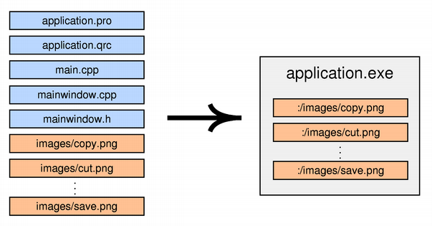
Resource System
Platform-independent mechanism for storing binary files
Not limited to images
Resource files stored in application's executable
Useful if application requires files
E.g. icons, translation files, sounds
Don't risk of losing files, easier deployment

Slide 172
Using Resources
Resources specified in .qrc file
Resources are accessible with ':’ prefix
Example: ":/images/cut.png”
Simply use resource path instead of file name
QIcon(":/images/cut.png")
To compile resource, edit .pro file
RESOURCES += application.qrc
qmake produces make rules to generate binary file
<!DOCTYPE RCC><RCC version="1.0">
<qresource>
<file>images/copy.png</file>
<file>images/cut.png</file>
...
</qresource>
</RCC>

Slide 173
Resource Specifics
Path Prefix
<qresource prefix="/myresources">
File accessible via ":/myresources/...”
Aliases
<file alias="cut.png">images/scissors.png</file>
File accessible via ":/cut.png"
Static Libraries and Resources
Need to force initialization
Q_INIT_RESOURCE(basename);
Loading resources at runtime
Use rcc to create binary and register resource
rcc -binary data.qrc -o data.rcc
QResource::registerResource("data.rcc")
Traverse resource tree using QDir(":/")

Slide 174
Lab – Upgrade Editor to Use Resources
Use your previous editor, to use Qt resource system for icons
Tip: You can use QtCreator to create QRC files

Slide 175
Translation for Developers

Slide 176
Internationalization (i18n)
This is by no means a complete guide!
Internationalization(i18n)
Designing applications to be adaptable to languages and regions without engineering changes.
Localization(l10n)
Adapting applications for region by adding components and translations
Qt supports the whole process:
QString supports unicode
On-screen texts (QObject::tr())
Number and date formats (QLocale)
Icons loading (Resource System)
Translation tool (Qt Linguist)
LTR and RTL text, layout and widgets (e.g. Arabic)
Plural handling (1 file vs. 2 files)

Slide 177
Text Translation
lupdate - scan C++ and .ui files for strings. Create/update .ts file
linguist - edit .ts file for adding translations
lrelease - read .ts and creates .qm file for release
QObject::tr(const char *srcTxt, const char *disambiguation = 0, int n = -1)
Mark translatable strings in C++ code
combine with QString::arg() for dynamic text
setWindowTitle(tr("File: %1 Line: %2").arg(f).arg(l));
//: This comment is seen by translation staff
label->setText(tr("Name: %1 Date: %2”).arg(name, d.toString()));

Slide 178
Translation Process

Slide 179
Local-Aware Applications
QLocale (Locale Qt.locale()) makes your applications locale-aware
Supports converting numbers to strings with different locale formatting
Possible to get the system locale and set the default locale
var fin = Qt.locale(“fi_FI”);
Numbers
Use %L1 to format a parameter according to the current locale
tr(“%L1 “).arg(someNumber);
Dates and Times
tr(“Today is %1”).arg(Date().toLocaleString(Qt.locale()));
Currencies
QLocale::system().currencySymbol();

Slide 180
Lab – Translate Editor to Your Locale Language
We use our existing editor
In the handout you will find a list of translation words
Use two character language code, e.g. de for German
Tip: You can use Qt Linguist to edit translations

Slide 181
Deploying Qt Applications

Slide 182
Ways of Deploying
Static Linking
Results in stand-alone executable
+ Only few files to deploy
− Executables are large
− No flexibility
− You cannot deploy plugins
Shared Libraries
+ Can deploy plugins
+ Qt libs shared between applications
+ Smaller, more flexible executables
− More files to deploy
Qt is by default compiled as shared library
If Qt is pre-installed on system
Use shared libraries approach

Slide 183
Deployment
Static Linkage Version
Build Qt statically
$QTDIR/configure -static <your other options>
Specify required options (e.g. sqldrivers)
Link application against Qt
Check that application runs stand-alone
Copy application to machine without Qt and run it
Shared Library Version
If Qt is not a system library
Need to redistribute Qt libs with application
Minimal deployment
Libraries used by application
Plugins used by Qt
Ensure Qt libraries use correct path to find Qt plugins

Slide 184
Deployment
The target platform has Qt libraries
Use INSTALLS variable in the .pro file to install any files
Use QCoreApplication::addLibraryPath()/setLibraryPaths() to add search path for plugins
target.files = someFille *.qml qml.dir
installDestination = $$[QT_INSTALL_QML]/MyModule/SubName
target.path = $$installDestination
INSTALLS += target
How to detect Qt version installed on the target?
qmake –v
Qt include folder
Platform dependent tools
Linux: ldd
OSX: otool
Windows: Dependency Walker

Slide 185
Deployment – The Target Does not Have Qt Libs
Create a static build
configure –static –platform
Create a bundle manually
Copy the relevant Qt libs/plugins to your bundle
Write a script which sets relevant environment variables and launches your application
#!/bin/sh
export LD_LIBRARY_PATH=`pwd`/qt_libs
export QML2_IMPORT_PATH=`pwd`/qt_libs/qml
export QT_QPA_PLATFORM_PLUGIN_PATH=`pwd`/qt_libs/plugins/platforms
./MyCoolApplication

Slide 186
Deployment – The Target Does not Have Qt Libs
Use platform-dependent (OSX, Windows) deployment tools in QTDIR/bin
macdeployqt, windeployqt
Some options
-no-plugins (by default all release plugins will be added, if the corresponding Qt module used)
-dmg create a disk image in OSX
Third party libraries must be still manually copied to the bundle/added to the installation package
You may need to handle different architectures 32/64 bit, Intel/PowerPC etc.
Create a custom binary installer
Create a package directory structure
Create a configuration file
Create a package information file
Create installer content and copy it to the package directory
Use the binarycreator tool to create the installer. The installer pages are created by using the information you provide in the configuration and package information file

Slide 187
Questions and Answers
What are the benefits of using QSettings?
Would you store any application data into the settings?
What can be stored into the settings
What are the differences between built-in and external resources?
Can resources be localized? If yes, how localized resources are loaded?
How mutual exclusion is handled in settings?
How strings are localized?
What support Qt has to develop locale-aware applications?
What tools exist for deploying Qt programs?

Slide 188
Summary
Persistent application settings may be stored and loaded with QSettings
Provides synchronization between threads
Resources may be deployed externally or internally using resource files
Resource file is an XML file, defining the content of resources
Actually resources are files or const char array, depending whether they are external or internal
Qt applications (and widgets) support
String localization
Resource localization
RTL and LTR text
Number, date, and currency formats based on the locale

Slide 189
Dialogs

Slide 190
Contents
Dialogs
Common Dialogs
Qt Designer

Slide 191
Objectives
Custom Dialogs
Modality
Inheriting QDialog
Dialog buttons
Predefined Dialogs
File, color, input and font dialogs
Message boxes
Progress dialogs
Wizard dialogs
Qt Designer
Design UI Forms
Using forms in your code
Dynamic form loading

Slide 192
Dialogs

Slide 193
Dialog Windows - QDialog
Base class of dialog window widgets
General Dialogs can have 2 modes
Modal dialog
Remains in foreground, until closed
Blocks input to remaining application
Example: Configuration dialog
Modeless dialog
Operates independently in application
Example: Find/Search dialog
MyDialog dialog(this);
dialog.setMyInput(text);
if(dialog.exec() == Dialog::Accepted) {
// exec blocks until user closes dialog

Slide 194
Modeless Dialog
Use show()
Displays dialog
Returns control to caller
void EditorWindow::find() {
if (!m_findDialog) {
m_findDialog = new FindDialog(this);
connect(m_findDialog, SIGNAL(findNext()), this,
SLOT(onFindNext()));
}
m_findDialog->show(); // returns immediately
m_findDialog->raise(); // on top of other windows
m_findDialog->activateWindow(); // keyboard focus
}

Slide 195
Custom Dialogs
Inherit from QDialog
Create and layout widgets
Use QDialogButtonBox for dialog buttons
Connect buttons to accept()/reject()
Override accept()/reject()
MyDialog::MyDialog(QWidget *parent) : QDialog(parent) {
m_label = new QLabel(tr("Input Text"), this);
m_edit = new QLineEdit(this);
m_box = new QDialogButtonBox( QDialogButtonBox::Ok |
QDialogButtonBox::Cancel, this);
connect(m_box, SIGNAL(accepted()), this, SLOT(accept()));
connect(m_box, SIGNAL(rejected()), this, SLOT(reject()));
... // layout widgets
}
void MyDialog::accept() { // customize close behaviour
if(isDataValid()) { QDialog::accept() }
}

Slide 196


Other Issues
Deletion of dialogs
No need to keep dialogs around forever
Call QObject::deleteLater()
Or setAttribute(Qt::WA_DeleteOnClose)
Or override closeEvent()
Dialogs with extensions:
QWidget::show()/hide() used on extension
m_more = new QPushButton(tr("&More"));
m_more->setCheckable(true);
m_extension = new QWidget(this);
// add your widgets to extension
m_extension->hide();
connect(m_more, SIGNAL(toggled(bool)), m_extension,
SLOT(setVisible(bool)));

Slide 197
Common Dialogs

Slide 198
Asking for Files - QFileDialog
Allow users to select files or directories
Asking for a file name
QString fileName = QFileDialog::getOpenFileName(this, tr("Open File"));
if(!fileName.isNull()) {
// do something useful
}
QFileDialog::getOpenFileNames()
Returns one or more selected existing files
QFileDialog::getSaveFileName()
Returns a file name. File does not have to exist.
QFileDialog::getExistingDirectory()
Returns an existing directory.
setFilter("Image Files (*.png *.jpg *.bmp)")
Displays files matching the patterns

Slide 199
Showing Messages - QMessageBox
Provides a modal dialog for…
Informing the user
Asking a question and receiving an answer
Typical usage, questioning a user
QMessageBox::StandardButton ret = QMessageBox::question(parent, title, text);
if(ret == QMessageBox::Ok) {
// do something useful
}
Very flexible in appearance
Other convenience methods
QMessageBox::information(...)
QMessageBox::warning(...)
QMessageBox::critical(...)
QMessageBox::about(...)

Slide 200
Feedback on Progress - QProgressDialog
Provides feedback on the progress of a slow operation
Initialize with setValue(0)
Otherwise estimation of duration will not work
When operation progresses, check for cancel
QProgressDialog::wasCanceled()
Or connect to QProgressDialog::canceled()
To stay reactive call QApplication::processEvents()
QProgressDialog dialog("Copy", "Abort", 0, count, this);
dialog.setWindowModality(Qt::WindowModal);
for (int i = 0; i < count; i++) {
dialog.setValue(i);
if (dialog.wasCanceled()) { break; }
//... copy one file
}
dialog.setValue(count); // ensure set to maximum

Slide 201

Providing Error Messages - QErrorMessage
Similar to QMessageBox with checkbox
Asks if message shall be displayed again
m_error = new QErrorMessage(this);
m_error->showMessage(message, type);
Messages will be queued
QErrorMessage::qtHandler()
Installs an error handler for debugging
Shows qDebug(), qWarning() and qFatal() messages in QErrorMessage box

Slide 202

Other Common Dialogs
Asking for Input – QInputDialog
QInputDialog::getText(...)
QInputDialog::getInt(...)
QInputDialog::getDouble(...)
QInputDialog::getItem(...)
Selecting Color – QColorDialog
QColorDialog::getColor(...)
Selecting Font – QFontDialog
QFontDialog::getFont(...)

Slide 203

Guiding the User - QWizard
Input dialog
Consisting of sequence of pages
Purpose: Guide user through process
Page by page
Supports
Linear and non-linear wizards
Registering and using fields
Access to pages by ID
Page initialization and cleanup
Title, sub-title
Logo, banner, watermark, background
Each page is a QWizardPage
QWizard::addPage() adds page to wizard

Slide 204
Simple Wizard Example
QWizardPage *createIntroPage() {
QWizardPage *page = new QWizardPage;
page->setTitle("Introduction");
// create widgets and layout them return page;
return page;
}
QWizardPage *createRegistrationPage() { ... }
int main(int argc, char *argv[]) {
QApplication app(argc, argv);
QWizard wizard;
wizard.setWindowTitle("License Wizard");
wizard.addPage(createIntroPage());
wizard.addPage(createRegistrationPage());
wizard.show();
return app.exec();
}

Slide 205
Questions And Answers
When would you use a modal dialog, and when would you use a non-modal dialog?
When should you call exec() and when should you call show()?
Can you bring up a modal dialog, when a modal dialog is already active?
When do you need to keep widgets as instance variables?
What is the problem with this code:
QDialog *dialog = new QDialog(parent);
QCheckBox *box = new QCheckBox(dialog);

Slide 206
Lab – Custom Dialog
We create a simple value dialog
Shows int value
As slider
As spin box
Value must be < 50 to be accepted
A main window will show result
Has a slider, connected to dialog
Two buttons to launch dialog in modal and modeless mode
lab-dialog

Slide 207
Qt Designer

Slide 208

Qt Designer
Design UI forms visually
Visual Editor for
Signal/slot connections
Actions
Tab handling
Buddy widgets
Widget properties
Integration of custom widgets
Resource files

Slide 209
Designer Views

Slide 210




Designer's Editing Modes
Widget Editing
Change appearance of form
Add layouts
Edit properties of widgets
Signal and Slots Editing
Connect widgets together with signals & slots
Buddy Editing
Assign buddy widgets to label
Buddy widgets help keyboard focus handling correctly
Tab Order Editing
Set order for widgets to receive the keyboard focus

Slide 211

Designer UI Form Files
Form stored in .ui file
Format is XML
uic tool generates code
From myform.ui to ui_myform.h
Form ui file in project (.pro)
FORMS += mainwindow.ui
// ui_mainwindow.h
class Ui_MainWindow {
public:
QLineEdit *fileName;
... // simplified code
void setupUi(QWidget *) { /* setup widgets */ }
};

Slide 212
From .ui to C+

Slide 213

Qt Creator - Form Wizards
Add New..."Designer Form”
Or "Designer Form Class” (for C++ integration)

Slide 214

Naming Widgets
Place widgets on form
Edit objectName property
objectName defines member name in generated code

Slide 215

Form Layout in Designer
QFormLayout: Suitable for most input forms

Slide 216

Top-Level Layout
First layout child widgets
Finally select empty space and set top-level layout

Slide 217

Preview Widget in Preview Mode
Check that widget is nicely resizable

Slide 218
Code Integration - Header File
"Your Widget” derives from appropriate base class
*ui member encapsulate UI class
Makes header independent of designer generated code
// orderform.h
class Ui_OrderForm;
class OrderForm : public QDialog {
private: Ui_OrderForm *ui; // pointer to UI object
};

Slide 219
Code Integration - Implementation File
Default behavior in Qt Creator
// orderform.cpp
#include "ui_orderform.h"
OrderForm::OrderForm(QWidget *parent) :
QDialog(parent),
ui(new Ui_OrderForm)
{
ui->setupUi(this);
}
OrderForm::~OrderForm()
{
delete ui;
ui=0;
}

Slide 220
Signals and Slots in Designer
Widgets are available as public members
ui->fileName->setText("image.png")
Name based on widgets object name
You can set up signals & slots traditionally...
connect(ui->okButton, SIGNAL(clicked()), ...
Auto-connection facility for custom slots
Automatically connect signals to slots in your code
Based on object name and signal
void on_objectName_signal(parameters);
Example: on_okButton_clicked() slot
Qt Creator: right-click on widget and "Go To Slot”
Generates a slot using auto-connected name

Slide 221
Using Custom Widgets in Designer
Forms can be processed at runtime
Produces dynamically generated user interfaces
Disadvantages
Slower, harder to maintain
Risk: .ui file not available at runtime
Loading .ui file
QUiLoader loader;
QFile file("forms/textfinder.ui");
file.open(QFile::ReadOnly);
QWidget *formWidget = loader.load(&file, this);
Locate objects in form
ui_okButton = qFindChild<QPushButton*>(this, "okButton");

Slide 222
Summary
Dialogs in Qt are specialized widgets
Both modal and modeless dialogs are supported
Modal dialogs start a nested event loop, preventing other windows in the application to handle events
Dialogs, like any forms, can be designed with Qt Designer

Slide 223

Lab – Designer Order Form
Create an order form dialog
With fields for price, quantity and total.
Total field updates itself to reflect quantity and price entered
lab-order-form

Slide 224
Model/View Framework

Slide 225
Contents
Model/View Concept
Showing Simple Data
Proxy Models
Custom Models

Slide 226
Objectives
Using Model/View
Introducing to the concepts of model-view
Showing Data using standard item models
Understand the limitations of standard item models
How to interface your model with a data backend
Understand what are proxy models and how to use them
Custom Models
Writing a simple read-only custom model

Slide 227
Model/View Concept

Slide 228
Why Model/View?
Isolated domain-logic
From input and presentation
Makes Components Independent
For Development
For Testing
For Maintenance
Foster Component Reuse
Reuse of Presentation Logic
Reuse of Domain Model

Slide 229
Model/View Components
Renders data items
View
Delegate
Fetches data items
Notifies about data changes
Model
Stores changed data items
Data
ex-simple

Slide 230

Model Structures

Slide 231


Display the Structure - View Classes
QtQuick ItemView
Abstract base class for scrollable views
QtQuick ListView
Items of data in a list
QtQuick GridView
Items of data in a grid
QtQuick PathView
Items of data along a specified path

Slide 232

Adapts the Data - Model Classes
QAbstractItemModel
Abstract interface of models
Abstract Item Models
Implement to use
Ready-Made Models
Convenient to use
Proxy Models
Reorder/filter/sort your items

Slide 233
Data - Model - View Relationships
View
Standard Item Model
Data+Model combined
View is separated
Model is your data
Custom Item Models
Model is adapter to data
View is separated
Model
Data
Model
View
Data

Slide 234
Addressing Data - QModelIndex
Refers to item in model
Contains all information to specify location
Located in given row and column
May have a parent index
QModelIndex API
row() - row index refers to
column() – column index refers to
parent() – parent of index
Or QModelIndex() if no parent
isValid()
Valid index belongs to a model
Valid index has non-negative row and column numbers
model() – the model index refers to
Data(role) - data for given role

Slide 235


QModelIndex in Table/Tree Structures
Rows and columns
Item location in table model
Item has no parent (parent.isValid() == false)
indexA = model->index(0, 0, QModelIndex());
indexB = model->index(1, 1, QModelIndex());
indexC = model->index(2, 1, QModelIndex());
Parents, rows, and columns
Item location in tree model
indexA = model->index(0, 0, QModelIndex());
indexC = model->index(2, 1, QModelIndex());
// asking for index with given row, column and parent
indexB = model->index(1, 0, indexA);

Slide 236

Item and Item Roles
Item performs various roles
For other components (delegate, view,...)
Supplies different data
For different situations
Example:
Qt::DisplayRole used display string in view
Asking for data
QVariant value = model->data(index, role);
// Asking for display text
QString text = model->data(index, Qt::DisplayRole).toString()
Standard roles
Defined by Qt::ItemDataRole

Slide 237
Mapping Item Roles from/to QML
Item Roles in C++
// Asking for display text
QString text = model->data(index, Qt::DisplayRole).toString()
Item properties in QML
onCurrentIndexChanged: { var text = model.get(index).display
}
Default mappings
Qt::DisplayRole in C++ is display in QML
Qt::DecorationRole in C++ is decoration in QML
Add additional mappings by re-implementing
QAbstractItemModel::roleNames()

Slide 238
Exporting Models to QML
Export model instance
Create model instance in C++
Set as a context property on the view's engine
CustomModel *model = new CustomModel;
QQuickView view;
view.engine()->rootContext("_model", model);
Use in QML by id
ListView { model: _model }
Export model type
Register custom model class with QML type system
qmlRegisterType<CustomModel>("Models", 1, 0, "CustomModel");
Use in QML like any other QML element
import Models 1.0
ListView {
model: CustomModel {}
}

Slide 239
Recap of Model/View Concept
Model Structures
List, Table and Tree
Components
Model - Adapter to Data
View - Displays Structure
Delegate – Paints Item
Index – Location in Model
Views
ListView
GridView
PathView
Models
QAbstractItemModel
Other Abstract Models
Ready-Made Models
Proxy Models
Index
row(), column(), parent()
data( role )
model()
Item Role
Qt::DisplayRole
Standard Roles in
Qt::ItemDataRoles

Slide 240
Showing Simple Data

Slide 241
QStandardItemModel - Convenient Model
QStandardItemModel
Classic item-based approach
Only practical for small sets of data
model = new QStandardItemModel(parent);
item = new QStandardItem("A (0,0)");
model->appendRow(item);
model->setItem(0, 1, new QStandardItem("B (0,1)"));
item->appendRow(new QStandardItem("C (0,0)"));
"B(0,1)” and "C(0,0)” – Not visible. (list view is only 1-dimensional)
ex-standarditemmodell

Slide 242

Meet the City Engine
Our Demo Model
62 most populous cities of the world
Data in CSV file
Data Columns
City | Country | Population | Area | Flag
Implemented as data backend
Internal implementation is hidden
Code in CityEngine class

Slide 243
Our Backend CityEngine API
public CityEngine : public QObject {
// returns all city names
QStringList cities() const;
// returns country by given city name
QString country(const QString &cityName) const;
// returns population by given city name
int population(const QString &cityName) const;
// returns city area by given city name
qreal area(const QString &cityName) const;
// returns country flag by given country name
QIcon flag(const QString &countryName) const;
// returns all countries
QStringList countries() const;
// returns city names filtered by country
QStringList citiesByCountry(const QString& countryName) const;
};

Slide 244

Lab: Standard Item Model for CityEngine
Implement setupModel() in citymodel.cpp
Display cities grouped by countries
lab-cities-standarditem

Slide 245
Proxy Models

Slide 246
Proxy Model - QSortFilterProxyModel
QSortFilterProxyModel
Transforms structure of source model
Maps indexes to new indexes
view = new QQuickView(parent);
// insert proxy model between model and view
proxy = new QSortFilterProxyModel(parent);
proxy->setSourceModel(model);
view->engine()->rootContext()->setContextProperty("_proxy", proxy);
Note: Need to load all data to sort or filter

Slide 247
Sorting/Filtering - QSortFilterProxyModel
Filter with Proxy Model
// filter column 1 by "India"
proxy->setFilterWildcard("India");
proxy->setFilterKeyColumn(1);
Sorting with Proxy Model
// sort column 0 ascending
proxy->sort(0, Qt::AscendingOrder);
Filter via TextInput’s signal
TextInput {
onTextChanged: _proxy.setFilterWildcard(text)
}
ex-sort-filter-tableview

Slide 248
Custom Models

Slide 249
Implementing a Model
Variety of classes to choose from
QAbstractListModel
One dimensional list
QAbstractTableModel
Two-dimensional tables
QAbstractItemModel
Generic model class
QStringListModel
One-dimensional model
Works on string list
QStandardItemModel
Model that stores the data

Slide 250
Step 1: Read Only List Model
class MyModel: public QAbstractListModel
{
public:
// return row count for given parent
int rowCount( const QModelIndex &parent) const;
// return data, based on current index and requested role
QVariant data( const QModelIndex &index,
int role = Qt::DisplayRole) const;
};
ex-stringlistmodel

Slide 251
Step 2: Suppling Header Information
QVariant MyModel::headerData(int section,
Qt::Orientation orientation,
int role) const
{
// return column or row header based on orientation
}
ex-stringlistmodel-2

Slide 252
Step 3: Enabling Editing
// should contain Qt::ItemIsEditable
Qt::ItemFlags MyModel::flags(const QModelIndex &index) const
{
return QAbstractListModel::flags() | Qt::ItemIsEditable;
}
// set role data for item at index to value
bool MyModel::setData( const QModelIndex & index,
const QVariant & value,
int role = Qt::EditRole)
{
... = value; // set data to your backend
emit dataChanged(topLeft, bottomRight); // if successful
}
ex-stringlistmodel-3

Slide 253
Step 4: Row Manipulation
// insert count rows into model before row
bool MyModel::insertRows(int row, int count, parent)
{
beginInsertRows(parent, first, last);
// insert data into your backend
endInsertRows();
}
// removes count rows from parent starting with row
bool MyModel::removeRows(int row, int count, parent)
{
beginRemoveRows(parent, first, last);
// remove data from your backend
endRemoveRows();
}
ex-stringlistmodel-4

Slide 254
Lab – City List Model
Please implement a City List Model
Given:
Start with solution of modelview/lab-cities-standarditem
Your Task:
Rebase CityModel to QAbstractListModel
Optional
Make the model editable
Enable adding / removing cities
sol-cities-standarditem

Slide 255
Delegates and Views

Slide 256
Contents
Delegates
Editing item data
Data Widget Mapper
Drag and Drop
Custom Tree Model

Slide 257
Objectives
Custom Model/View
Editable Models
Custom Delegates
Using Data Widget Mapper
Custom Proxy Models
Drag and Drop

Slide 258
Delegates

Slide 259
Item Delegates
QAbstractItemDelegate subclasses
Control appearance of items in views
Provide edit and display mechanisms
QItemDelegate, QStyledItemDelegate
Default delegates
Suitable in most cases
Modelneedstoprovideappropriatedata
When to go for Custom Delegates?
More control over appearance of items

Slide 260

Item Appearance
Data table shown has no custom delegate
No need for custom delegate!
Use Qt::ItemRole to customize appearance

Slide 261

Delegate from QAbstractItemDelegate
class BarGraphDelegate : public QAbstractItemDelegate {
public:
void paint(QPainter *painter,
const QStyleOptionViewItem &option,
const QModelIndex &index) const;
QSize sizeHint(const QStyleOptionViewItem &option,
const QModelIndex &index) const;
};

Slide 262
Integer Value - Bar Graph Delegate
void BarGraphDelegate::paint(painter, option, index) const
{
if(index.data(Qt::EditRole).userType() == QVariant::Int) {
int value = index.data(Qt::EditRole).toInt();
// prepare rect with a width proportional to value
QRect rect(option.rect.adjusted(4,4,-4,-4));
rect.setWidth(rect.width()*value/MAX_VALUE);
// draw the value bar
painter->fillRect(rect, QColor("steelblue").lighter(value));
painter->drawText(option.rect, index.data().toString());
}
}
QSize BarGraphDelegate::sizeHint(option, index) const
{
Q_UNUSED(index)
return QSize(MIN_BAR_WIDTH, option.fontMetrics.height());
}
ex-bargraph-delegate

Slide 263
Editing Item Data

Slide 264

An Editor Delegate
Provides QComboBox
For editing a series of values
class CountryDelegate : public QItemDelegate
{
public:
// returns editor for editing data
QWidget *createEditor( parent, option, index ) const;
// sets data from model to editor void
setEditorData( editor, index ) const;
// sets data from editor to model
void setModelData( editor, model, index ) const;
// updates geometry of editor for index
void updateEditorGeometry( editor, option, index ) const;
};

Slide 265
Providing an Editor
Create editor by index
Set data to editor
QWidget *CountryDelegate::createEditor( ... ) const {
QComboBox *editor = new QComboBox(parent);
editor->addItems( m_countries );
return editor;
}
void CountryDelegate::setEditorData( ... ) const {
QComboBox* combo = static_cast<QComboBox*>( editor );
QString country = index.data().toString();
int idx = m_countries.indexOf( country );
combo->setCurrentIndex( idx );
}

Slide 266
Submitting Data to the Model
When user finished editing
View asks delegate to store data into model
If editor has finished editing
void CountryDelegate::setModelData(editor, model, index) const {
QComboBox* combo = static_cast<QComboBox*>( editor );
model->setData( index, combo->currentText() );
}
// copy edtitors data to model
emit commitData( editor );
// close/destroy editor
emit closeEditor( editor, hint );
// hint: indicates action performed next to editing

Slide 267
Updating the Editor's Geometry
Delegate manages editor's geometry
View provides geometry information
QStyleOptionViewItem
.
Case of multi-index editor
Position editor in relation to indexes
void CountryDelegate::updateEditorGeometry( ... ) const {
// don't allow to get smaller than editors sizeHint()
QSize size = option.rect.size().expandedTo(editor->sizeHint());
QRect rect(QPoint(0,0), size);
rect.moveCenter(option.rect.center());
editor->setGeometry( rect );
}
ex-editor-delegate

Slide 268
Setting Delegates on Views
view->setItemDelegate( ... )
view->setItemDelegateForColumn( ... )
view->setItemDelegateForRow(... )

Slide 269

Type-Based Delegates
Our color editor widget
Registering editor for type QVariant::Color
class ColorListEditor : public QComboBox {
...
};
QItemEditorFactory *factory = new QItemEditorFactory;
QItemEditorCreatorBase *creator = new
QStandardItemEditorCreator<ColorListEditor>();
// registers item editor creator given type of data
factory->registerEditor(QVariant::Color, creator);
// new and existing delegates will use new factory
QItemEditorFactory::setDefaultFactory(factory);

Slide 270
Data Widget Mapper

Slide 271
Data Widget Mapper- QDataWidgetMapper
Maps model sections to widgets
Widgets updated, when current index changes
Orientation
Horizontal => Data Columns
Vertical => Data Rows

Slide 272
Using QDataWidgetMapper
Mapping Setup
Track Navigation
mapper = new QDataWidgetMapper(this);
mapper->setOrientation(Qt::Horizontal);
mapper->setModel(model);
// mapper->addMapping( widget, model-section)
mapper->addMapping(nameEdit, 0);
mapper->addMapping(addressEdit, 1);
mapper->addMapping(ageSpinBox, 2);
// populate widgets with 1st row
mapper->toFirst();
connect(nextButton, &QPushButton::clicked, mapper, &QSignalMapper::toNext);
connect(previousButton, &QPushButton::clicked, mapper,
&QSignalMapper::toPrevious);

Slide 273
Mapped Property - The USER Property
USER indicates property is user-editable property
Only one USER property per class
Used to transfer data between the model and the widget
addMapping(lineEdit, 0); // uses "text" user property
addMapping(lineEdit, 0, "inputMask"); // uses named property
class QLineEdit : public QWidget
{
...
Q_PROPERTY(QString text
READ text WRITE setText NOTIFY textChanged
USER true) // USER property
...
};

Slide 274
Drag and Drop

Slide 275
Drag and Drop for Views
Enable the View
Model has to provide support for drag and drop operations
Model needs to support actions
For example Qt::MoveAction
Implement MyModel::removeRows( ... )
// enable item dragging
view->setDragEnabled(true);
// allow to drop internal or external items
view->setAcceptDrops(true);
// show where dragged item will be dropped
view->setDropIndicatorShown(true);
Qt::DropActions MyModel::supportedDropActions() const
{
return Qt::CopyAction | Qt::MoveAction;
}

Slide 276
Drag and Drop with QStandardItemModel
Setup of Model
Model is ready by default
model->mimeTypes()
"application/x-qabstractitemmodeldatalist”
"application/x-qstandarditemmodeldatalist”
model->supportedDragActions()
QDropEvent::Copy | QDropEvent::Move
model->supportedDropActions()
QDropEvent::Copy | QDropEvent::Move
item = new QStandardItem("Drag and Droppable Item");
// drag by default copies item
item->setDragEnabled(true);
// drop mean adding dragged item as child
item->setDropEnabled(true);
ex-dnd-list

Slide 277
Drag and Drop on QAbstractItemModel
class MyModel : public QAbstractItemModel {
public:
// actions supported by the data in this model
Qt::DropActions supportedDropActions() const;
// for supported index return Qt::ItemIs(Drag|Drop)Enabled
Qt::ItemFlags flags(const QModelIndex &index) const;
// returns list of MIME types that are supported
QStringList QAbstractItemModel::mimeTypes() const;
// returns object with serialized data in mime formats
QMimeData *mimeData(const QModelIndexList &indexes) const;
// true if data and action can be handled, otherwise false
bool dropMimeData(const QMimeData *data, Qt::DropAction action,
int row, int column, const QModelIndex &parent);
};
ex-drag-and-drop

Slide 278
Custom Tree Models

Slide 279
A Custom Tree Model in 5 Steps
Read-Only Model
Editable Model
Insert-Remove Model
Lazy Model
Drag and Drop Model

Slide 280
A (Simple) Node Structure
class Node {
public:
Node(const QString& aText="No Data", Node *aParent=0);
~Node();
QVariant data() const;
public:
QString text;
Node *parent;
QList<Node*> children;
};
Demo: ex-tree-model

Slide 281
Read-Only Model
class ReadOnlyModel : public QAbstractItemModel
{
public:
...
QModelIndex index( row, column, parent ) const;
QModelIndex parent child ) const;
int rowCount( parent ) const;
int columnCount( parent ) const;
QVariant data( index, role) const;
protected: // important helper methods
QModelIndex indexForNode(Node *node) const;
Node* nodeForIndex(const QModelIndex &index) const;
int rowForNode(Node *node) const;
};

Slide 282
Editable Model
class EditableModel : public ReadOnlyModel {
public:
...
bool setData( index, value, role );
Qt::ItemFlags flags( index ) const;
};

Slide 283
Insert Remove Model
class InsertRemoveModel : public EditableModel {
public:
...
void insertNode(Node *parentNode, int pos, Node *node);
void removeNode(Node *node);
void removeAllNodes();
};

Slide 284
Lazy Model
class LazyModel : public ReadOnlyModel {
public:
...
bool hasChildren( parent ) const;
bool canFetchMore( parent ) const;
void fetchMore( parent );
};

Slide 285
DnD Model
class DndModel : public InsertRemoveModel {
public:
...
Qt::ItemFlags flags( index ) const;
Qt::DropActions supportedDragActions() const;
Qt::DropActions supportedDropActions() const;
QStringList mimeTypes() const;
QMimeData *mimeData( indexes ) const;
bool dropMimeData(data, dropAction, row, column, parent);
bool removeRows(row, count, parent);
bool insertRows(row, count, parent);
};
ex-tree-model

Slide 286
Questions and Answers
In Qt model/view framework, what are view, model, delegate, role, item, index?
What kind of item model classes exist?
When would you implement a custom delegate?
How delegate data is written to the model?
How model data is sorted?
Who owns the model?
Can models be shared between views?
Is it possible to use the same model in widgets and QML?

Slide 287
Summary
Qt model/view framework allows the separation of model and views
Model classes derive from QAbstractItemModel
Custom models can be implemented for memory and performance optimizations
Model data is referenced with index
A data item may have several roles
Roles will be used by the delegate to render the item
Model subclasses exist for sorting and filtering model data
Models may support
Lazy loading
Drag and drop

Slide 288
GraphicsView

Slide 289
Contents
Using GraphicsView Classes
Coordinate Systems and Transformations
Creating Custom Items

Slide 290
Objectives
Using QGraphicsView-related classes
Coordinate Schemes, Transformations
Extending items
Event handling
Painting
Boundaries

Slide 291
Using GraphicsView Classes

Slide 292
GraphicsView Framework
Provides:
A surface for managing interactive 2D graphical items
A view widget for visualizing the items
Uses MVC paradigm
Resolution Independent
Animation Support
Fast item discovery, hit tests, collision detection
Using Binary Space Partitioning (BSP) tree indexes
Can manage large numbers of items (tens of thousands)
Supports zooming, printing and rendering
Basis of Qt Charts and Qt Quick 1

Slide 293
Hello World
#include <QtWidgets>
int main(int argc, char *argv[])
{
QApplication app(argc, argv);
QGraphicsView view;
QGraphicsScene *scene = new QGraphicsScene(&view);
view.setScene(scene);
QGraphicsRectItem *rect = new QGraphicsRectItem(-10, -10, 120, 50);
scene->addItem(rect);
QGraphicsTextItem *text = scene->addText("Hello World!");
view.show();
return app.exec();
}
ex-helloworld

Slide 294

UML Relationship
QGraphicsScene is:
A "model” for QGraphicsView
A "container” for QGraphicsItems

Slide 295
QGraphicsScene
Container for Graphic Items • Items can exist in only one scene at a time
Propagates events to items
Manages Collision Detection
Supports fast item indexing
Manages item selection and focus
Renders scene onto view
z-order determines which items show up in front of others

Slide 296
QGraphicsScene Important Methods
addItem()
Add an item to the scene
(remove from previous scene if necessary)
Also addEllipse(), addPolygon(), addText(), etc.
items()
Returns items intersecting a particular point or region
selectedItems()
Returns list of selected items
sceneRect()
Bounding rectangle for the entire scene
QGraphicsEllipseItem *ellipse = scene->addEllipse(-10, -10, 120, 50);
QGraphicsTextItem *text = scene->addText("Hello World!");

Slide 297
QGraphicsView
Scrollable widget view port onto the scene
Zooming, rotation, and other transformations
Translates input events (from the View) into QGraphicsSceneEvents
Maps coordinates between scene and viewport
Provides "level of detail” information to items
Supports OpenGL

Slide 298
QGraphicsView Important Methods
setScene()
Sets the QGraphicsScene to use
setRenderHints()
antialiasing, smooth pixmap transformations, etc.
centerOn()
Takes a QPoint or a QGraphicsItem as argument
Ensures point/item is centered in View
mapFromScene(), mapToScene()
Map to/from scene coordinates
scale(), rotate(), translate(), matrix()
transformations

Slide 299
QGraphicsItem
Abstract base class: basic canvas element
Supports parent/child hierarchy
Easy to extend or customize concrete items:
QGraphicsRectItem, QGraphicsPolygonItem, QGraphicsPixmapItem, QGraphicsTextItem, etc.
SVG Drawings, other widgets
Items can be transformed:
move, scale, rotate
Using local coordinate systems
Supports Drag and Drop similar to QWidget

Slide 300

Concrete QGraphicsItem Types
ex-concrete-items

Slide 301
QGraphicsItem Important Methods
pos()
Get the item's position in scene
moveBy()
Moves an item relative to its own position.
zValue()
Get a Z order for item in scene
show(), hide() – set visibility
setEnabled(bool) - disabled items can not take focus or receive events
setFocus(Qt::FocusReason) - sets input focus.
setSelected(bool)
select/deselect an item
Typically called from QGraphicsScene::setSelectionArea()

Slide 302
Select, Focus, Move
QGraphicsItem::setFlags()
Determines which operations are supported on an item
QGraphicsItemFlags
QGraphicsItem::ItemIsMovable
QGraphicsItem::ItemIsSelectable
QGraphicsItem::ItemIsFocusable
item->setFlags(QGraphicsItem::ItemIsMovable |
QGraphicsItem::ItemIsSelectable);

Slide 303

Groups of Items
Any QGraphicsItem can have children
QGraphicsItemGroup is an invisible item for grouping child items
To group child items in a box with an outline (for example), use a QGraphicsRectItem
Try dragging boxes in demo:
ex-concrete-items

Slide 304
Parents and Children
Parent propagates values to child items:
setEnabled()
setFlags()
setPos()
setOpacity()
etc...
Enables composition of items.

Slide 305
Coordinate System and Transformations

Slide 306

Coordinate Systems
Each View and Item has its own local coordinate system

Slide 307
Coordinates
Coordinates are local to an item
Logical coordinates, not pixels
Floating point, not integer
Without transformations, 1 logical coordinate = 1 pixel.
Items inherit position and transform from parent
zValue is relative to parent
Item transformation does not affect its local coordinate system
Items are painted recursively
From parent to children
In increasing zValue order

Slide 308
QTransform
Coordinate systems can be transformed using Qtransform
QTransform is a 3x3 matrix describing a linear transformation from (x, y) to (xt, yt)
m₁₃ and m₂₃
Control perspective transformations
col1 | col2 | col3
m₁₁ | m₁₂ | m₁₃
m₂₁ | m₂₂ | m₂₃
m₃₁ | m₃₂ | m₃₃
xt = m₁₁*x + m₂₁*y + m₃₁
yt = m₂₂*y + m₁₂*x + m₃₃
if projected:
wt = m₁₃*x + m₂₃*y + m₃₃
xt /= wt
yt /= wt

Slide 309

Common Transformations
Commonly-used convenience functions:
scale()
rotate()
shear()
translate()
Saves you the trouble of defining transformation matrices
rotate() takes optional 2nd argument: axis of rotation.
Z axis is "simple 2D rotation”
Non-Z axis rotations are "perspective” projections.

Slide 310
View Transformations
setTransformationAnchor()
An anchor is a point that remains fixed before/after the transform.
AnchorViewCenter: (Default) The center point remains the same
AnchorUnderMouse: The point under the mouse remains the same
NoAnchor: Scrollbars remain unchanged.
t = QTransform(); // identity matrix
t.rotate(45, Qt::ZAxis); // simple rotate
t.scale(1.5, 1.5) // scale by 150%
view->setTransform(t); // apply transform to entire view

Slide 311
Item Transformations
QGraphicsItem supports same transform operations:
setTransform(), transform()
rotate(), scale(), shear(), translate()
An item's effective transformation:
The product of its own and all its ancestors' transformations
TIP: When managing the transformation of items, store the desired rotation, scaling etc. in member variables and build a QTransform from the identity transformation when they change. Don't try to deduce values from the current transformation and/or try to use it as the base for further changes.

Slide 312
Zooming
Zooming is done with view->scale()
void MyView::zoom(double factor)
{
double width = matrix().mapRect(QRectF(0, 0, 1, 1)).width();
width *= factor;
if ((width < 0.05) || (width > 10))
return;
scale(factor, factor);
}

Slide 313
Mapping between Coordinate Systems
Mapping methods are overloaded for QPolygonF, QPainterPath etc.
mapFromScene(const QPointF&):
Maps a point from scene coordinates to item coordinates. Inverse: mapToScene(const QPointF&)
mapFromItem(const QGraphicsItem*, const QPointF&)
Maps a point from another item's coordinate system to this item's .Inverse: mapToItem(const QGraphicsItem*, const QPointF&).
Special case: mapFromParent(constQPointF&).

Slide 314
Ignoring Transformations
Sometimes we don't want particular items to be transformed before display.
View transformation can be disabled for individual items.
Used for text labels in a graph that should not change size when the graph is zoomed.
item->setFlag( QGraphicsItem::ItemIgnoresTransformations);

Slide 315

Transforms Demo
ex-transformination

Slide 316
Creating Custom Items

Slide 317
Extending QGraphicsItem
QGraphicsItem pure virtual methods (required overrides):
void paint()
Paints contents of item in local coordinates
QRectF boundingRect()
Returns outer bounds of item as a rectangle
Called by QGraphicsView to determine what regions need to be re-drawn
QPainterPath shape() – shape of item
Used by contains() and collidesWithPath() for collision detection
Defaults to boundingRect() if not implemented

Slide 318

Boundaries

Slide 319
Painting Items
Item is in complete control of drawing itself
Use standard QPainter drawing methods
QPen, QBrush, pixmaps, gradients, text, etc.
No background to draw
Dynamic boundary and arbitrary shape
Polygon, curved, non-contiguous, etc.

Slide 320

Custom Item example
class PendulumItem : public QGraphicsItem {
public:
QRectF boundingRect() const;
void paint(QPainter* painter, const QStyleOptionGraphicsItem* option,
QWidget* widget);
};

Slide 321
paint() and boundingRect()
boundingRect() must take the pen width into consideration
QRectF PendulumItem::boundingRect() const {
return QRectF(-20.0 - PENWIDTH/2.0, -PENWIDTH/2.0,
40.0 + PENWIDTH, 140.0 + PENWIDTH );
}
void PendulumItem::paint( QPainter* painter,
const QStyleOptionGraphicsItem*, QWidget*) {
painter->setPen( QPen( Qt::black, PENWIDTH ) );
painter->drawLine(0,0,0,100);
QRadialGradient g( 0, 120, 20, -10, 110 );
g.setColorAt( 0.0, Qt::white );
g.setColorAt( 0.5, Qt::yellow );
g.setColorAt( 1.0, Qt::black );
painter->setBrush(g);
painter->drawEllipse(-20, 100, 40, 40);
}

Slide 322
Choosing a boundingRect()
boundingRect()
Influences drawing code
Influences "origin” of item transforms
i.e. for Pendulum that swings:
Good origin is non-weighted end of line
Can rotate around(0,0) without translation

Slide 323
QGraphicsItemGroup
Easier approach to making a Pendulum:
Extend QGraphicsItemGroup
Use other concrete items as elements, add as children
No need to override paint() or shape()
PendulumItem::PendulumItem(QGraphicsItem* parent) :
QGraphicsItemGroup(parent) {
m_line = new QGraphicsLineItem( 0,0,0,100, this);
m_line->setPen( QPen( Qt::black, 3 ) );
m_circle = new QGraphicsEllipseItem( -20, 100, 40, 40, this );
m_circle->setPen( QPen(Qt::black, 3 ));
QRadialGradient g( 0, 120, 20, -10, 110 );
g.setColorAt( 0.0, Qt::white );
g.setColorAt( 0.5, Qt::yellow );
g.setColorAt( 1.0, Qt::black );
m_circle->setBrush(g);
}
ex-pendelum

Slide 324
Event Handling
QGraphicsItem::sceneEvent(QEvent*)
Receives all events for an item
Similar to QWidget::event()
Specific typed event handlers:
keyPressEvent(QKeyEvent*)
mouseMoveEvent(QGraphicsSceneMouseEvent*)
wheelEvent(QGraphicsSceneWheelEvent*)
mousePressEvent(QGraphicsSceneMouseEvent*)
contextMenuEvent(QGraphicsSceneContextMenuEvent*)
dragEnterEvent(QGraphicsSceneDragDropEvent*)
focusInEvent(QFocusEvent*)
hoverEnterEvent(QGraphicsSceneHoverEvent*)
When overriding mouse event handlers:
Make sure to call base-class versions, too. Without this, the item select, focus, move behavior will not work as expected.

Slide 325
Event Handler Examples
void MyView::wheelEvent(QWheelEvent *event)
{
double factor = 1.0 + (0.2 * qAbs(event->delta()) / 120.0);
if (event->delta() > 0) zoom(factor);
else zoom(1.0/factor);
}
void MyView::keyPressEvent(QKeyEvent *event)
{
switch (event->key()) {
case Qt::Key_Plus:
zoom(1.2);
break;
case Qt::Key_Minus:
zoom(1.0/1.2);
break;
default:
QGraphicsView::keyPressEvent(event);
}
}

Slide 326
Collision Detection
Determines when items’ shapes intersect
Two methods for collision detection:
collidesWithItem(QGraphicsItem* other)
collidingItems(Qt::ItemSelectionMode)
shape()
Returns QPainterPath used for collision detection
Must be overridden properly
items()
Overloaded forms take QRectF, QPolygonF, QPainterPath
Return items found in rect/polygon/shape

Slide 327

Lab – Corner Drag Button
Definea QGraphicsItem which can display an image, and has at least 1 child item, that is a "corner drag" button, permitting the user to click and drag the button, to resize or rotate the image.
Start with the handout, provided in lab-corner-drag
Further details are in the readme.txt in the same directory

Slide 328
Widgets in a Scene

Slide 329

Widgets in a Scene

Slide 330
Items Are not Widgets
QGraphicsItem:
Lightweight compared to QWidget
No signals/slots/properties
Scenes can easily contain thousands of Items
Uses different QEvent sub-hierarchy (derived from QGraphicsSceneEvent)
Supports transformations directly
QWidget:
Derived from QObject (less light-weight)
Supports signals, slots, properties, etc.
Can be embedded in a QGraphicsScene with a QGraphicsProxyWidget

Slide 331

QGraphicsWidget
Advanced functionality graphics item
Provides signals/slots, layouts, geometry, palette, etc.
Not a QWidget
Base class for QGraphicsProxyWidget

Slide 332
QGraphicsProxyWidget
QGraphicsItem that can embed a QWidget in a QGraphicsScene
Handles complex widgets like QFileDialog
Takes ownership of related widget
Synchronizes states/properties:
visible, enabled, geometry, style, palette, font, cursor, sizeHint, windowTitle, etc.
Proxies events between Widget and GraphicsView
If either (widget or proxy) is deleted, the other is also!
Widget must not already have a parent
Only top-level widgets can be added to a scene

Slide 333
Embedded Widget Example
#include <QtWidgets>
int main(int argc, char **argv)
{
QApplication app(argc, argv);
QCalendarWidget *calendar = new QCalendarWidget;
QGraphicsScene scene;
QGraphicsProxyWidget *proxy = scene.addWidget(calendar);
QGraphicsView view(&scene);
view.show();
return app.exec();
}

Slide 334
QGraphicsLayout
For layout of QGraphicsLayoutItem (+derived) classes in QGraphicsView
Concrete classes:
QGraphicsLinearLayout: equivalent to QBoxLayout, arranges items horizontally or vertically
QGraphicsGridLayout: equivalent to QGridLayout, arranges items in a grid
QGraphicsWidget::setLayout() - set layout for child items of this QGraphicsWidget

Slide 335

Lab: Widgets in a Scene
Starting with the lab-map-viewer handout, add zooming controls.
Suggested widgets:
QPushButtons for +/-
QSlider for selecting zoom level directly.
Use QGraphicsLayout to layout the widgets
Make the mouse work like a "hand-grab” tool on drag, so we can see different zoomed areas.

Slide 336
Drag and Drop

Slide 337
Drag and Drop
Items can be:
Dragged
Dropped onto other items
Dropped onto scenes
For handling empty drop areas

Slide 338
Start Drag
Starting an item drag is similar to dragging from a QWidget.
Override event handlers:
mousePressEvent()
mouseMoveEvent()
In mouseMoveEvent(), decide if drag started? If so:
Create a QDrag instance
Attach a QMimeData to it
See section on Drag and Drop for QMimeData info
Call QDrag::exec()
Function returns when user drops
Does not block event loop

Slide 339
Drop on a Scene
Override QGraphicsScene::dropEvent()
To accept drop:
acceptProposedAction()
setDropAction(Qt::DropAction); accept();
Override QGraphicsScene::dragMoveEvent()
Optional overrides:
dragEnterEvent(), dragLeaveEvent()

Slide 340
startDrag() Example
void startDrag( Qt::DropActions supportedActions ) {
if ( selectedItems().size()>0 ) {
QListWidgetItem *item = selectedItems()[0];
QDrag* drag = new QDrag( this );
QMimeData *mimeData = new QMimeData; [...]
QGraphicsItem* gitem = DiagramItem::createItem(
item->toolType() );
mimeData->setData( "application/x-qgraphicsitem-ptr",
QByteArray::number( ( qulonglong )gitem ) );
drag->setMimeData( mimeData );
QPixmap pix = item->icon().pixmap( 111,111 );
drag->setPixmap( pix );
drag->setHotSpot( pix.rect().center() );
if ( drag->exec(supportedActions) == Qt::IgnoreAction ) {
delete gitem; // drag cancelled, must delete item
}
ex-drag-drop-item

Slide 341
dropEvent() on a Scene
void DiagramScene::dropEvent( QGraphicsSceneDragDropEvent* event) {
if (event->mimeData()->hasFormat("application/x-qgraphicsitem-ptr")) {
QGraphicsItem* item = reinterpret_cast<QGraphicsItem*>(
event->mimeData()->data (
"application/x-qgraphicsitem-ptr").toULongLong() );
if ( item ) {
addItem( item );
item->setFlag( QGraphicsItem::ItemIsMovable );
item->setFlag( QGraphicsItem::ItemIsSelectable );
item->setFlag( QGraphicsItem::ItemIsFocusable );
item->setPos( event->scenePos() );
event->acceptProposedAction();
}
}
else
/* Call baseclass to allow per-item dropEvent */
QGraphicsScene::dropEvent( event );
}
ex-drag-drop-item

Slide 342
Drop on an Item
To drop into an item:
Override dragEnterEvent()
Optional override: dragMoveEvent() (if the item can only accept drops in some parts of its area)
void DiagramItem::dragEnterEvent(QGraphicsSceneDragDropEvent* e) {
if ( e->mimeData()->hasColor() )
e->acceptProposedAction();
}
void DiagramScene::dragEnterEvent(QGraphicsSceneDragDropEvent* e) {
if (e->mimeData()->hasFormat(
"application/x-qgraphicsitem-ptr"))
e->acceptProposedAction();
else
QGraphicsScene::dragEnterEvent(e);
}
ex-drag-drop-item

Slide 343
Effects

Slide 344




Graphics Effects
Effects can be applied to graphics items:
Base class for effects is QGraphicsEffect
Standard effects include blur, colorize, opacity and drop shadow.
Effects are set on items.
QGraphicsItem::setGraphicsEffect()
Effects cannot be shared or layered.
Custom effects can be written.

Slide 345
Using a Graphics Effect
Applying a blur effect to a pixmap.
An effect is owned by the item that uses it.
Updating an effect causes the item to be updated.
QPixmap pixmap(":/images/qt-banner.png");
QGraphicsItem *blurItem = scene->addPixmap(pixmap);
QGraphicsBlurEffect *blurEffect = new QGraphicsBlurEffect();
blurItem->setGraphicsEffect(blurEffect);
blurEffect->setBlurRadius(5);

Slide 346
Performance Tuning

Slide 347
Level of Detail
Don't draw what you can't see
QStyleOptionGraphicsItem passed to paint()
Contains palette, state, matrix members
qreal levelOfDetailFromTransform(QTransform T) method
"levelOfDetail” is max width/height of the unity rectangle needed to draw this shape onto a QPainter with a QTransform of T.
Use worldTransform() of painter for current transform.
Zoomed out: levelOfDetail < 1.0
Zoomed in: levelOfDetail > 1.0

Slide 348

Level of Detail: Chip Demo

Slide 349
Level of Detail: Chip Demo 2
void Chip::paint(QPainter *painter,
const QStyleOptionGraphicsItem *option, QWidget *)
{
const qreal lod = option->levelOfDetailFromTransform(
painter->worldTransform());
[ ... ]
if (lod >= 2) {
QFont font("Times", 10);
font.setStyleStrategy(QFont::ForceOutline);
painter->save();
painter->setFont(font);
painter->scale(0.1, 0.1);
painter->drawText(170, 180, QString("Model: VSC-2000 ..."
painter->drawText(170, 220, QString("Manufacturer: ..."
painter->restore();
}

Slide 350
Caching Tips
Cache item painting into a pixmap
So paint() runs faster
Cache boundingRect() and shape()
Avoid re-computing expensive operations that stay the same
Be sure to invalidate manually cached items after zooming and other transforms
QRectF MyItem::boundingRect() const {
if (m_rect.isNull())
calculateBoundingRect();
return m_rect;
}
QPainterPath MyItem::shape() const {
if (m_shape.isEmpty())
calculateShape();
return m_shape;
}

Slide 351
setCacheMode()
Property of QGraphicsView and QGraphicsItem
Allows caching of pre-rendered content in a QPixmap
Drawn on the viewport
Especially useful for gradient shape backgrounds
Invalidated whenever view is transformed.
QGraphicsView view;
view.setBackgroundBrush(QImage(":/images/backgroundtile.png"));
view.setCacheMode(QGraphicsView::CacheBackground);

Slide 352
Tweaking
The following methods allow you to tweak performance of view/scene/items:
QGraphicsView::setViewportUpdateMode()
QGraphicsView::setOptimizationFlags()
QGraphicsScene::setItemIndexMethod()
QGraphicsScene::setBspTreeDepth()
QGraphicsItem::setFlags()
ItemDoesntPropagateOpacityToChildren and ItemIgnoresParentOpacity especially recommended if your items are opaque!

Slide 353
Tips for Better Performance
boundingRect() and shape() are called frequently so they should run fast!
boundingRect() should be as small as possible
shape() should return simplest reasonable path
Try to avoid drawing gradients on the painter
Consider using pre-rendered backgrounds from images instead.
It is costly to dynamically insert/remove items from the scene
Consider hiding and reusing items instead.
Embedded widgets in a scene is costly.
Try using a different paint engine (OpenGL, Direct3D, etc.)
setViewport (new QGLWidget);
Avoid curved and dashed lines
Alpha blending and antialiasing are expensive

Slide 354
Questions and Answers
How many scenes can be attached to a view? How many views can render a single scene?
How events are propagated to graphic items?
How do you use property animations with graphic items?’’
How transformations are applied to a graphics view or a graphics item?
When is it beneficial to use binary space partitioning for accessing scene index?
What is level of detail and how is it used?
Which classes does QGraphicsViewItem derive from?
What should be taken, when embedding widgets into a scene?
How to use OpenGL for painting graphic items, painted with QPainter?
How graphics view performance can be adjusted?

Slide 355
Summary
Graphics view provides a light-weight framework for rendering possibly a large number of graphical items
Items are managed by a scene, which can be shared by several graphics view widgets
The scene forward events from the view widget to very light-weight graphic items
In addition to event handling, items can be transformed and grouped to make their management easier
Standard widgets may be embedded into the graphics view, but has a performance penalty
Several options exist to adjust graphics performance
BSP index use, widget background caching, item caching, level of detail information

Slide 356
Charts

Slide 357
Contents
Chart Types
Using Qt Model Data in Charts
Dynamic Charts
User Interactions
Themes and Customization

Slide 358
Objectives
Learn…
…Qt chart types
…how to add and modify chart data
…how to use item models for providing chart data
…how to customize charts

Slide 359








Qt Charts – Chart Types
Line chart
Spline chart
Area chart
Scatter chart
Pie chart (pie, donut)
Bar chart (bar, stacked, percent)
Polar chart
Candlestick chart

Slide 360

Charts Architecture
Charts API is based on the Qt Graphics View framework
Charts can be displayed as graphics widgets using QChart
Provides API for zooming and scrolling
QChartView allows using the chart as a widget
Each chart type is represented by QAbstractSeries derived class

Slide 361

Series
Determines the chart type
To use a certain chart type, create an instance of a series class and add it to the QChart instance
Series can be dynamically removed and added

Slide 362
Series Example
Add data to series
Add series to charts
Create axes
QLineSeries* series = new QLineSeries();
series->add(0, 6);
series->add(2, 4);
// ...
chartView->chart()->addSeries(series);
chartView->chart()->createDefaultAxes();

Slide 363


Legend
Shows what the chart data represents
Fully automatic
Default legend placement options:
Top, Bottom, Left or Right
Simple API to change
Legend background pen and brush
Label brush
Marker shape (rectangle, circle, default, from series)
Or draw yourself
Set new parent to legend
Chart updates legend state with signals, but won’t draw it
Legend aligned to right
Legend Detached and drawn on top of chart

Slide 364
Axis
Controls the presentation of series
Only one x-axis may be visible at the time
If there are several y-axes, they share the common x-axes
Several axis type exist (enumeration in QAbstractAxis::AxisType)
No axis, value axis, category and bar category axis, date and time axis, logarithmic axis
Series type | X-axis | Y-axis
QXYSeries | QValueAxies | QValueAxis
QBarSeries | QBarCategoryAxis | QValueAxis
QPieSeries | None | None

Slide 365

Axis
Can be setup to show tick marks, grid lines, and shades
Default axes can be created
QChart::createDefeaultAxes()
Must be called after the series has been added to the chart
chart.axisX()->setRange(0, 20);
chart.axisY()->setRange(0, 10);
chart.axisY()->setShadesVisible(true);
chart.axisY()->setShadesColor(QColor(0, 0, 255, 100));
static_cast<QValueAxis *>(chart.axisX())->setTickCount(10);

Slide 366



Line Charts
Spline is exactly similar to line chart except an spline is drawn between the points in QSplineSeries
Scatter chart is created similarly, but QScatterSeries is used
Additionally, marker properties can be set
Two line series can be added to an area series
QAreaSeries(lineSeries1, lineSeries2);
Set the pen and brush to QAreaSeries to paint the area
QScatterSeries *series1 = new QScatterSeries();
series1->setName("scatter2");
series1->setMarkerShape(QScatterSeries::MarkerShapeCircle);
series1->setMarkerSize(20.0);
*series1 << QPointF(1, 1) << QPointF(3, 3) << QPointF(7, 6)
<< QPointF(8, 3) << QPointF(10, 2);

Slide 367



Bar Charts
Bar chart types
Bar draws bars as groups, where bars in same category are grouped next to each other.
Stacked bar bar draws the bars in same category stacked on top of each other
Percent Bar draws bars as stacks, where each bar is shown as percentage of all bars in that category
To create horizontal bar charts
Use QHorizontal*BarSeries classes
// Create a Bar Set
QBarSet *set0 = new QBarSet("Jane");
// Insert data
*set0 << 1 << 2 << 3 << 4 << 5 << 6;
// Create Bar Series and add Bar Set
QBarSeries* series = new QBarSeries();
// Create Chart and add Series
QChart* chart = new QChart();
chart->addSeries(series);
chart->setTitle("Simple grouped barchart example");

Slide 368
Bar Charts – Categories
To display categories on axis
Create QBarCategoryAxis
Append one or more categories as QString or QStringList
Set the category to an axis
If you use QChart::createDefaultAxes()
Set the axis to the chart after calling this function
Otherwise, the default axis will override the category axis
QStringList categories;
categories << "Jan" << "Feb" << "Mar" << "Apr" << "May" << "Jun";
QBarCategoryAxis* axis = new QBarCategoryAxis();
axis->append(categories);
chart->createDefaultAxes();
chart->setAxisX(axis,series);

Slide 369

Pie Charts
A simple API with two main classes
QPieSeries
QPieSlice
Appearance can be fully customized
Pie size and position
Donut like
Slice pen, brush, label font, etc.
Signals for user interaction
Hover, clicked
Basic animations support
Adding, removing and exploding slices

Slide 370
Pie Chart Example
QPieSeries *series = new QPieSeries();
series->append("Jane", 1);
series->append("Joe", 2);
series->append("Andy", 3);
series->append("Barbara", 4);
series->append("Axel", 5);
QPieSlice *slice = series->slices().at(1);
slice->setExploded();
slice->setLabelVisible();
slice->setPen(QPen(Qt::darkGreen, 2));
slice->setBrush(Qt::green);

Slide 371


Pie Charts – Drilldown
Implement, e.g., with QPieSlice signals
When the slice is clicked
Change the series to show another pie chart
Note that QChart::removeSeries() deletes the series object
Store it in some other object, unless you want to re-create the series data

Slide 372
Pie Charts – Drilldown
QPieSeries* yearSeries = new QPieSeries(&window);
yearSeries->setName("Sales by year - All");
QList<QString> months; months << "Jan" << "Feb" << "Mar" << "Apr"
<< "May" << "Jun" << "Jul" << "Aug" << "Sep" << "Oct" << "Nov" << "Dec";
QList<QString> names; names << "Jane" << "John" << "Axel" << "Mary" << "Susan" << "Bob";
for (const QString &name, names) {
QPieSeries *series = new QPieSeries(&window);
series->setName("Sales by month - " + name);
for (const QString &month, months)
// DrilldownSlice is QPieSlice sub-class, containing the series and
// functionality to update the percentage label and expand the slice
*series << new DrilldownSlice(qrand() % 1000, month, yearSeries);
QObject::connect(series, &QPieSeries::clicked, chart, &Chart::handleSliceClicked); *yearSeries << new DrilldownSlice(series->sum(), name, series);
} QObject::connect(yearSeries, &QPieSeries::clicked, chart, &Chart::handleSliceClicked); chart->changeSeries(yearSeries);

Slide 373


User Interaction
Hover and clicked signals provide a good start for user interaction
Drill-down for instance
Zooming in/out and scrolling also supported

Slide 374

Zooming and Scrolling
QChart::zoom(qreal factor)
QChart::zoomIn()
QChart::zoomIn(const QRectF& rect)
void QChart::scroll (qreal dx, qreal dy)
Easy to integrate to Qt Gesture FW

Slide 375
Gesture Example (Zoom Line SDK Example)
bool Chart::gestureEvent(QGestureEvent *event)
{
if (QGesture *gesture = event->gesture(Qt::PanGesture)) {
QPanGesture *pan = static_cast<QPanGesture *>(gesture);
QChart::scroll(-(pan->delta().x()), pan->delta().y());
} if (QGesture *gesture = event->gesture(Qt::PinchGesture)) {
QPinchGesture *pinch = static_cast<QPinchGesture *>(gesture);
if (pinch->changeFlags() & QPinchGesture::ScaleFactorChanged)
QChart::zoom(pinch->scaleFactor());
} return true;
}

Slide 376
Using Model Data in Charts
QAbstractItemModel can be used as a data source for the series:
Vertical and horizontal orientation
Data area (i.e. how data is presented in a chart) is done with series specific model mapper classes
Charts series are updated when changes are made to the model (data updated, rows or columns inserted or removed)
Obviously, the model must support data insert and removal as well
This is especially handy when
integrating user interfaces with table and chart presentation
creating interactive charts with data entry forms

Slide 377
Model Mappers
Keep your series and the actual model in sync
Both APIs may be used at the same time:
Series model API or QAbstractItemModel API
No common base class for model mappers
QHXYModelMapper/QVXYModelMapper
Define which model rows/columns mapped (and kept sync) to the points in the XY series
Define the first column/row and the number of columns/rows, if only part of the model data used
QHBarModelMapper/QVBarModelMapper
Similarly to XY model mappers, define which model rows/columns mapped to bar sets
QHPieModelMapper/QVPieModelMapper
Define a row/column, which contains values and another row/column, which contains labels

Slide 378

Model Mappers
// The model is a table with two columns
QVXYModelMapper *mapper = new QVXYModelMapper(this);
mapper->setXColumn(0);
mapper->setYColumn(1);
mapper->setSeries(series);
mapper->setModel(model);
chart->addSeries(series);
// The model is a table with six columns
int first = 3; int count = 5;
QVBarModelMapper *mapper = new QVBarModelMapper(this);
mapper->setFirstBarSetColumn(1);
mapper->setLastBarSetColumn(4);
mapper->setFirstRow(first); // First 3 rows skipped
mapper->setRowCount(count); // Only 5 rows mapped
mapper->setSeries(series);
mapper->setModel(model);

Slide 379

Dynamic Charts
Chart series can be dynamically altered
Dynamically adding/changing values in a series
The chart reacts automatically, nothing special here
Changing the range of axes (scrolling)

Slide 380
Scrolling Approaches
QAbstractAxis::scroll(qreal dx, qreal dy)
Automated animation
QAbstractAxis::setRange(x,y)
Over timer or by new incoming values
Will progress as setRange is called
QValueAxis properties min and max with a QPropertyAnimation
Have Qt Animation FW do the iteration

Slide 381
Time-Bound Scrolling
Use a timer (QTimer or timer events) to refresh ”painting” aka. to set the range
Bind the new range values to real elapsed time using QTime
class MainWindow : public QMainWindow
{
…
private:
QTime m_startTime; …
};
// mainwindow.cpp
void MainWindow::startScrolling()
{
m_startTime.start();
}
void MainWindow::scroll()
{
double secsGone = m_startTime.elapsed() / 1000.0;
if (secsGone >= 10.0) m_chart->axisX()->setRange(secsGone-10,secsGone);
}

Slide 382







Theming
Easy theming
Several different “one-line” themes available
myChart->setTheme(QChart::ChartThemeLight);
All colors and attributes modifiable through the API
Start from the scratch or
Modify an existing theme

Slide 383


Chart Customization
Lots of properties for customizing the look’n’feel manually
Trying out the examples gives you the best overview on customizable features

Slide 384
Questions and Answers
Mention some Qt chart types
How chart type is defined?
Is it possible to add data into the series dynamically?
Does the chart automatically scale to show all data in the series?
How axis can be customized?
Can user interact with line points or bars in charts by clicking on them?
How item models are mapped to charts? Is it possible to pick up a subset of the model?

Slide 385
Summary
Qt Charts provides a comprehensive selection of different chart types
Line charts, pie charts, bar charts, candle stick charts
Charts are based on the graphics view framework
Chart itself derives from QGraphicsWidget
Charts type depends on series
Series provide the data for the chart
Items may be dynamically added and removed from the series
Aixs may be scrolled, when new items are added or removed
Custom user interactions may be implemented by re-implementing event handlers

Slide 386
Thank You!
www.qt.io

